Slide 1


Developing Writers, Developing Thinkers
Jodi Wheeler-Toppen, Ph.D.

Slide 2
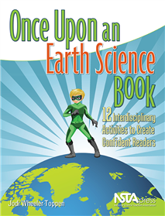
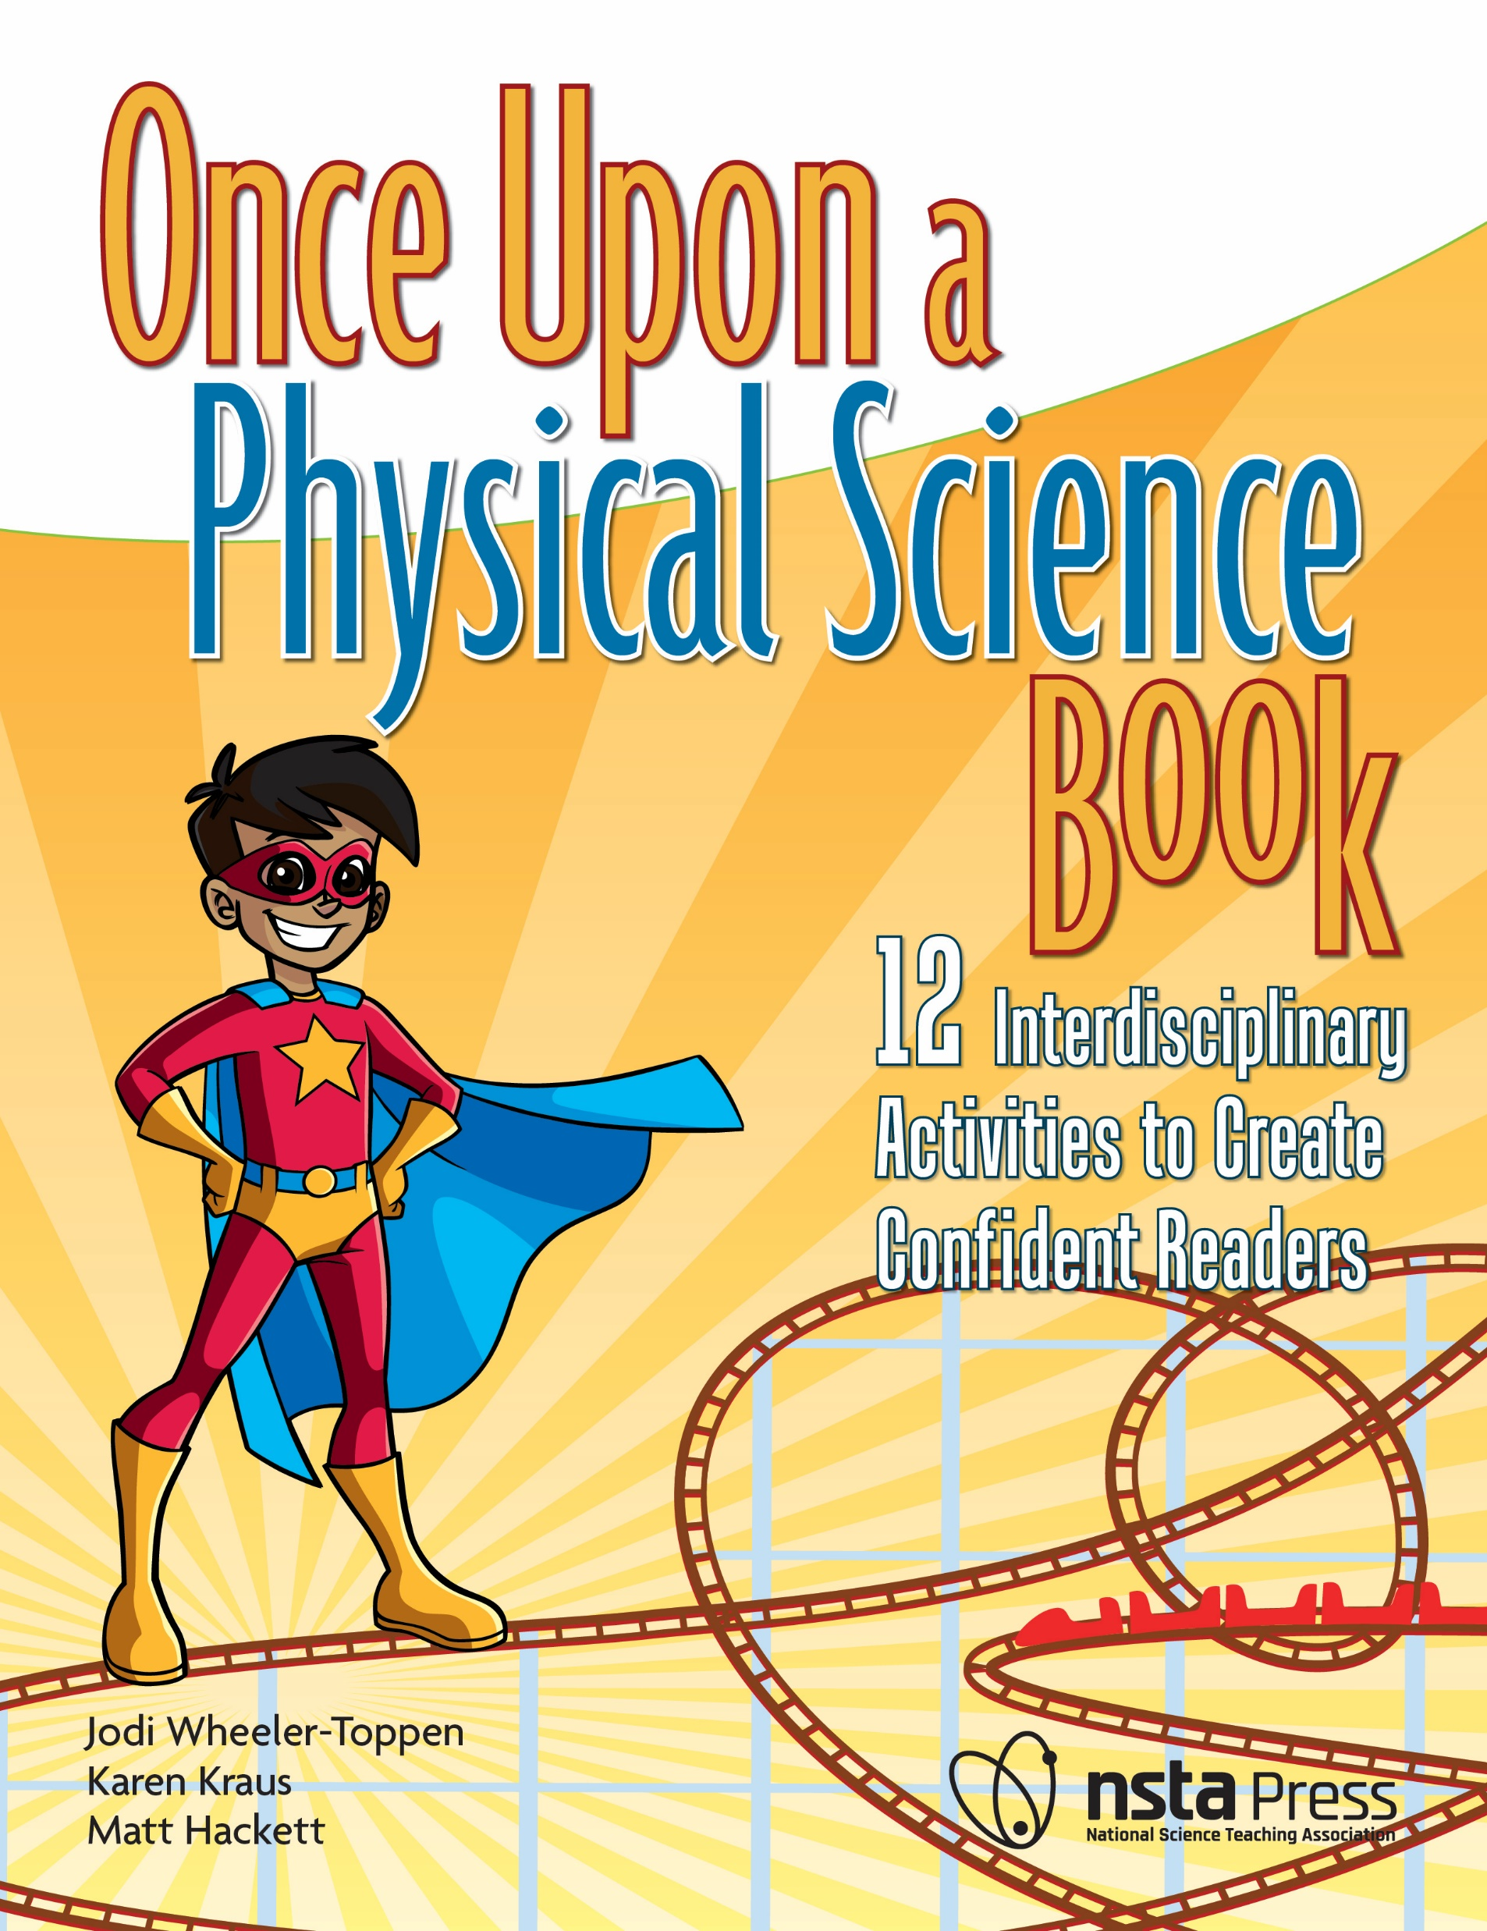

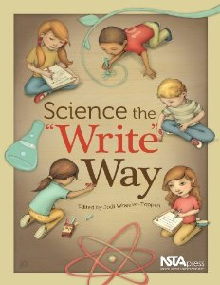
Who I am and
How I ended up here

Slide 3
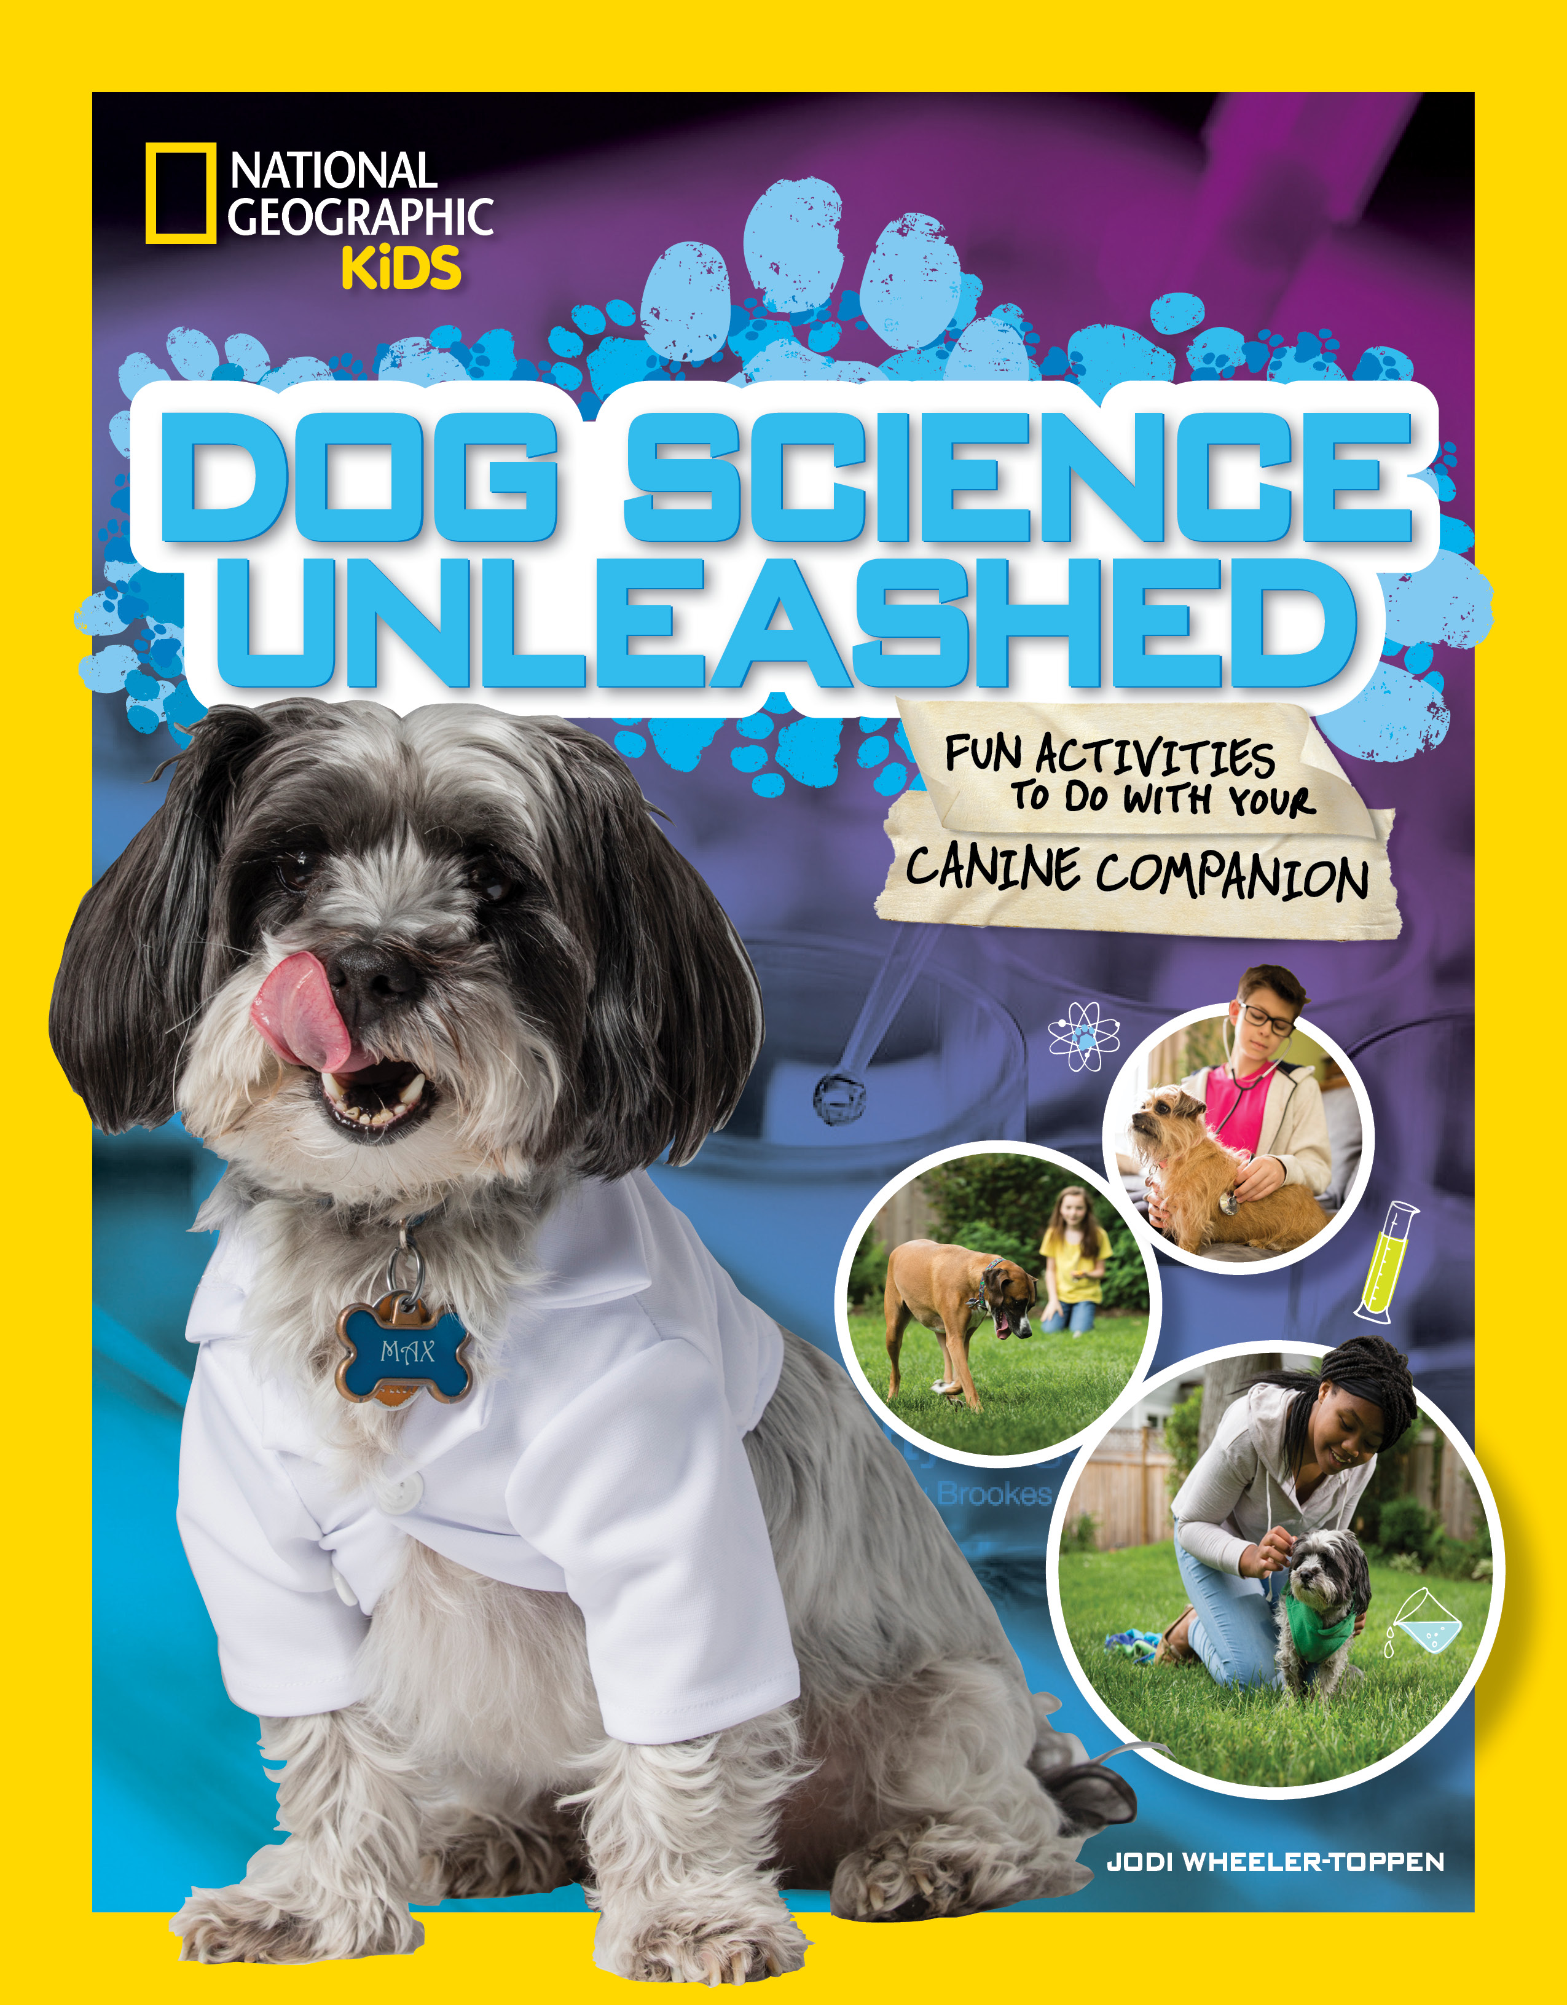
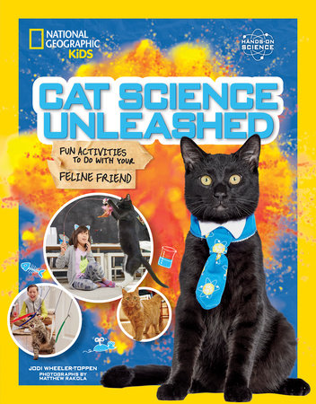


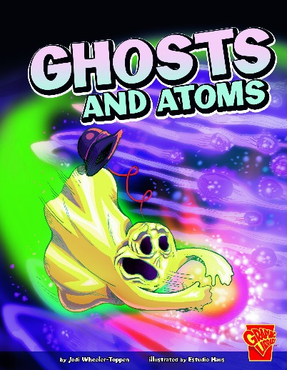
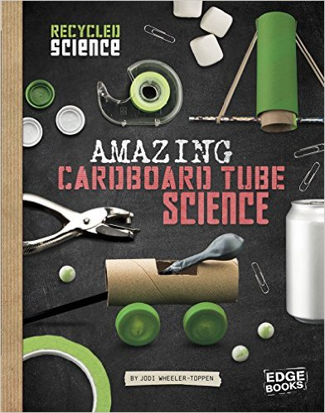
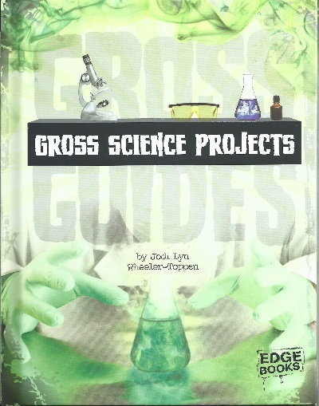
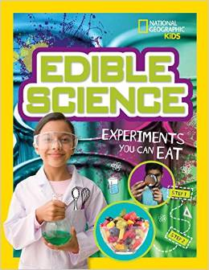

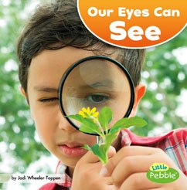

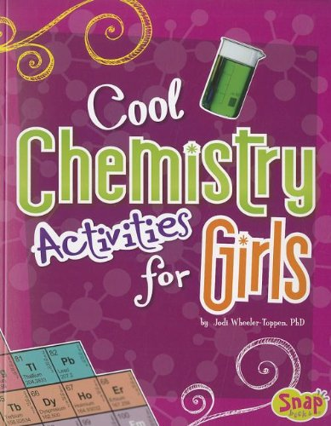
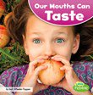
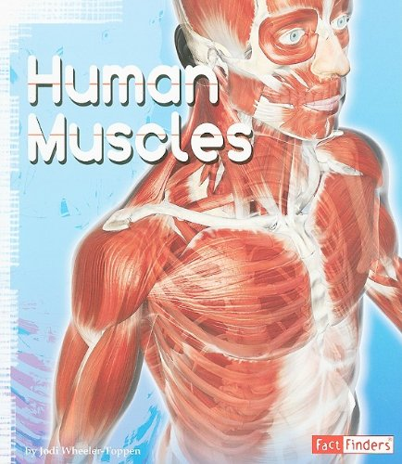
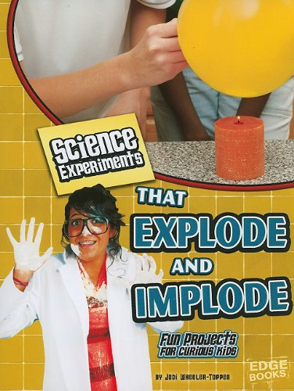
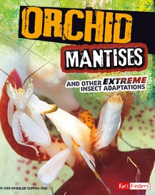
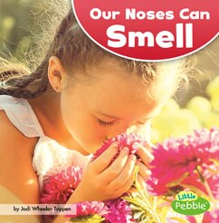


Slide 4
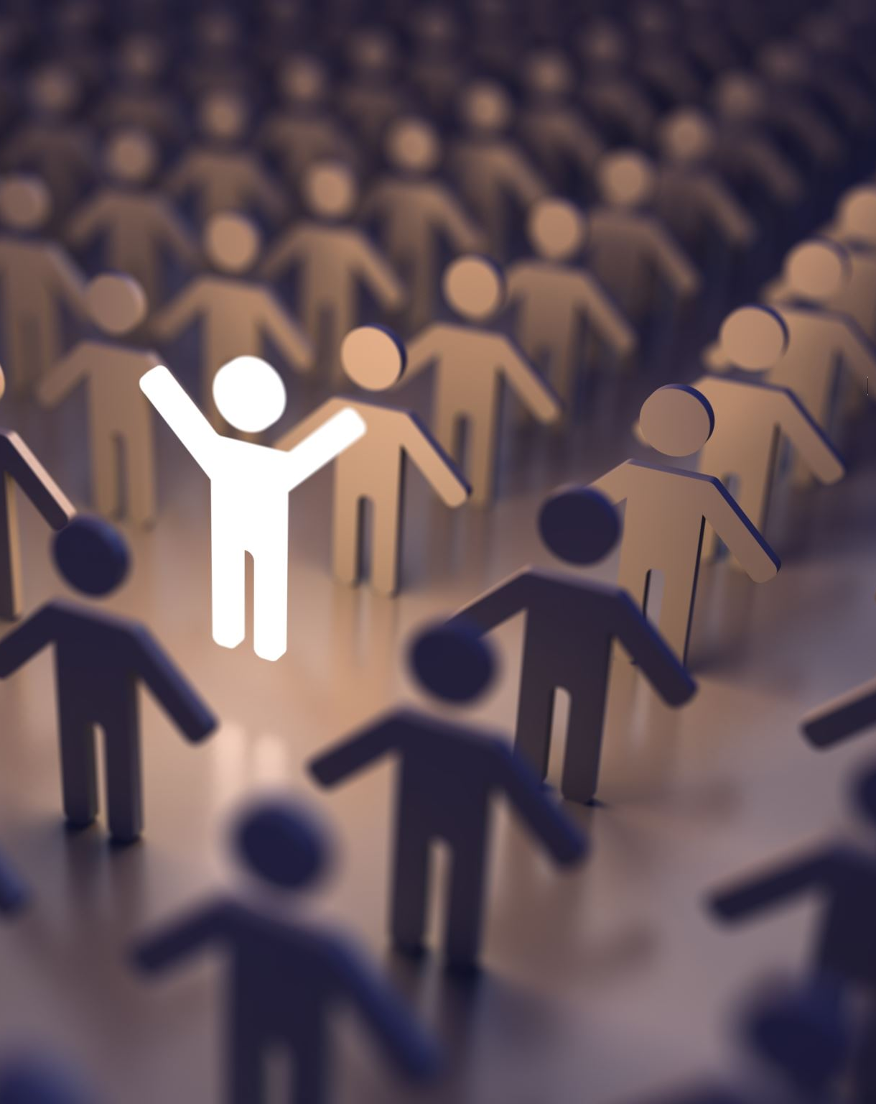
Help me know who you are and what you need!

Slide 5
Classroom writing falls on a spectrum.
Writing to Learn (exploratory)
Writing for a Finished Product
Experiences
Discussions
Reading, Reading, Reading
I’m an Expert!
Experience
Reading
Discussion
What am I learning?
Writing
Proofreading
End Product
Revision, Revision, Revision
Notes:
Ask yourself where this writing task is falling on the spectrum. Keep your expectations in check for what you’ve decided they are doing.

Slide 6
Raise your hand if you have ever…
Put off answering an email that was going to require a lot of thought?
Failed to write a thank-you note you knew you should write?
Started to keep a journal but then it petered out?
Procrastinated in writing up a report on something that you needed to get done?
Writing is hard work.

Slide 7
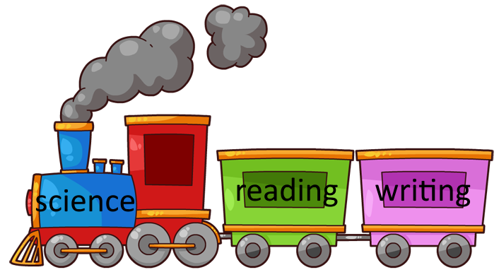
It’s easier if you have something to say.
Notes:
This is why it helps to put the writing as the caboose on the train.

Slide 8
It’s easier if you have something to say.
Do interesting tasks. Real science.
Hands-on.
Figuring things out, not replicating what you’ve already been told.
Help students work out the ideas before they start writing.

Slide 9
The more time you spend helping students prepare to write, the better your results will be.

Slide 10
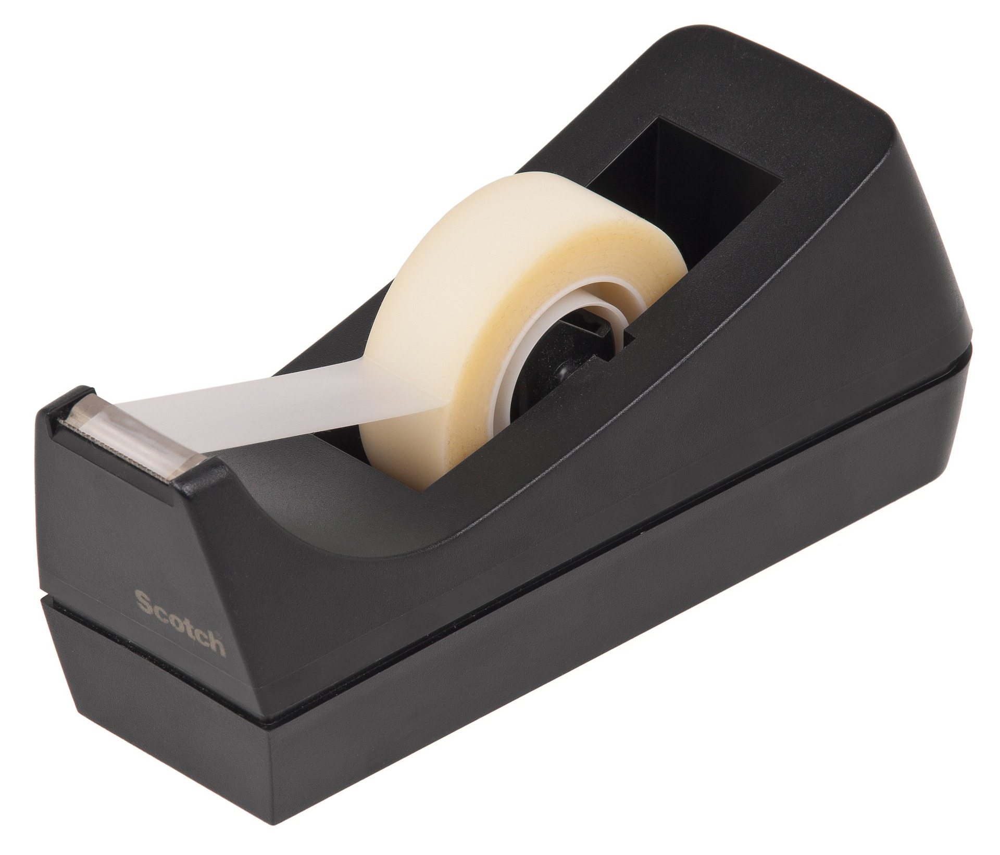
Sticky Tape Mini-Lab
Find the complete lab (with student lab pages and article) in Once Upon a Physical Science Book, Chapter 6: All Charged Up

Slide 11
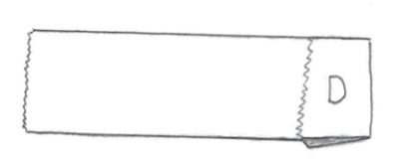
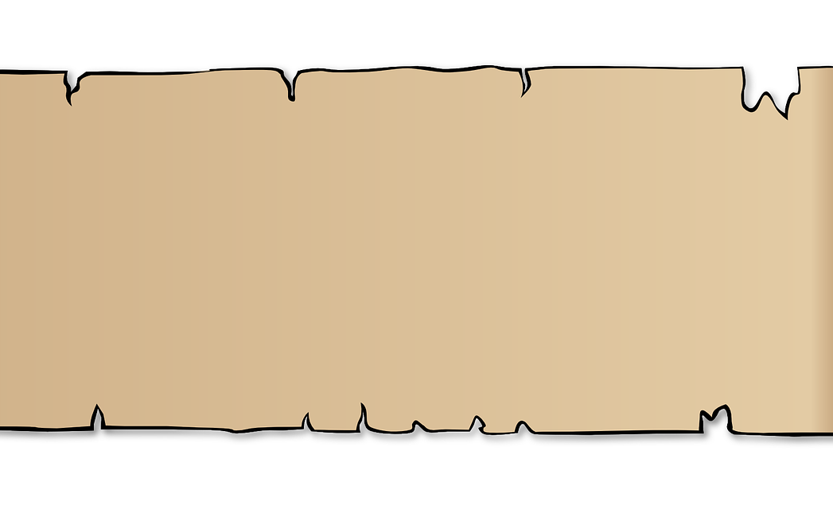
Mini-lab
Create a D “desk tape”
Create a matching strip of paper
Compare how each responds to a pencil

Slide 12
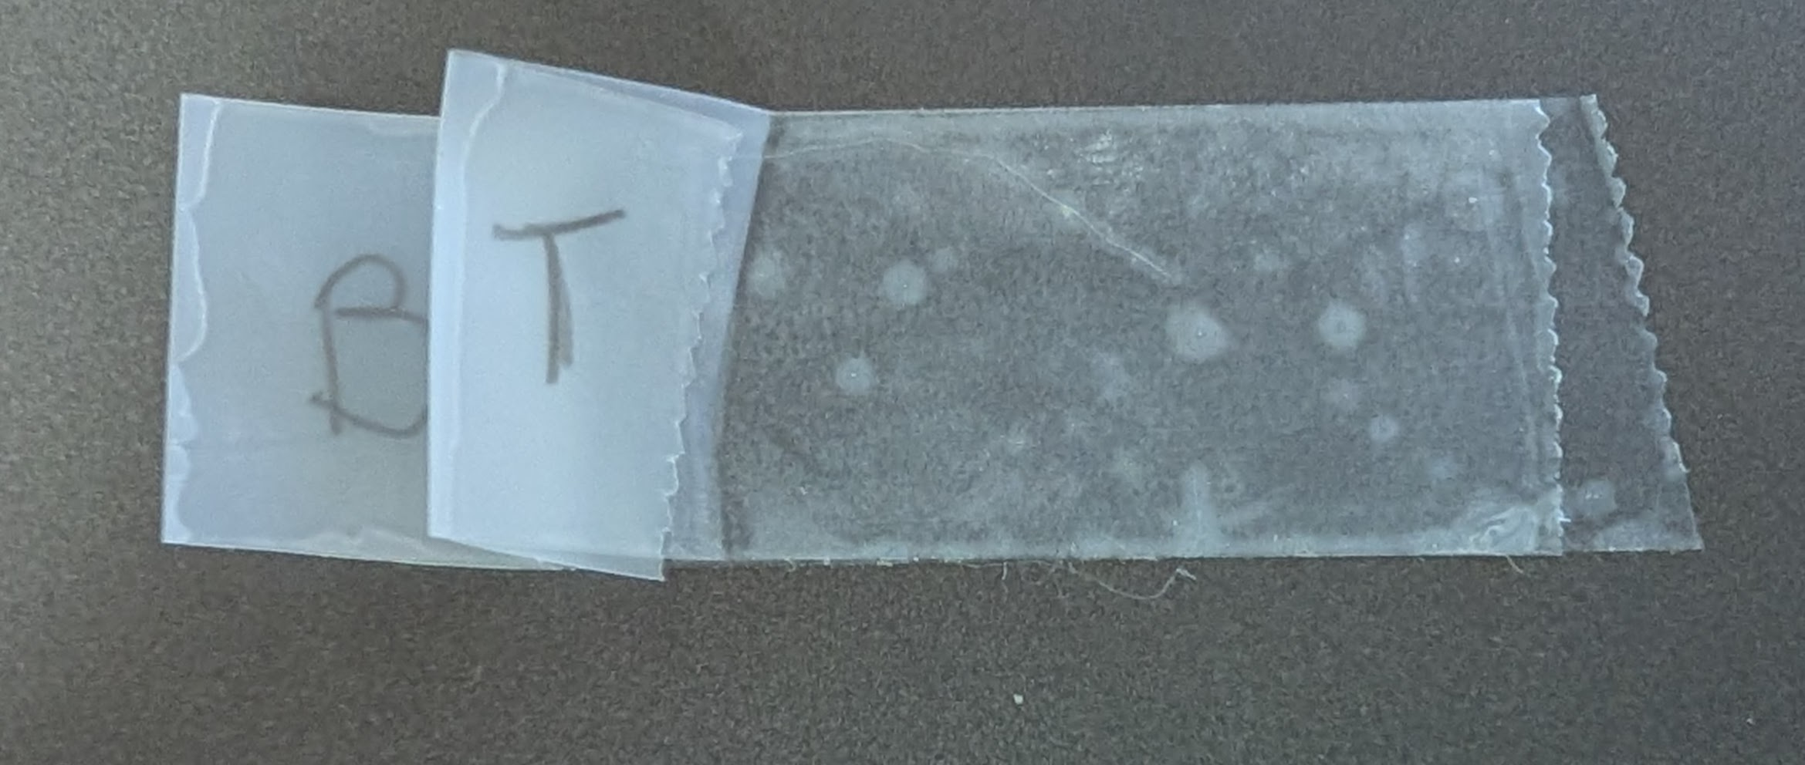
Create a Bottom-Top (B-T) tape combination
Explore how these two tapes interact
Explore how they interact with a fresh D tape

Slide 13
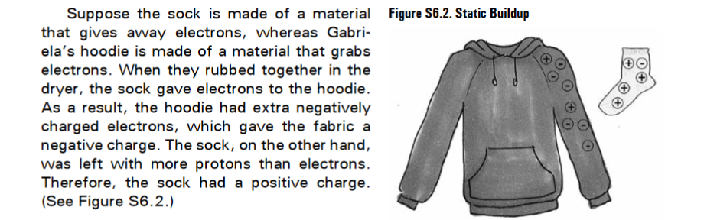
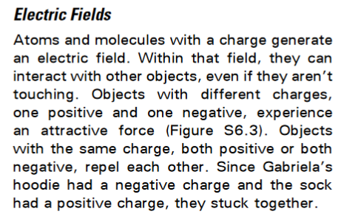
Mini-text

Slide 14

Let’s take this a step further.
Rubber balloons pick up electrons very easily (and thus become negative). Rub your balloon vigorously with the felt. Make a fresh Tape D. Use the balloon to determine the charge on Tape D.
Writing Prompt: What is the charge on Tape D? Make an argument to support your position. Include what must be happening at the atomic level to create that charge.

Slide 15
Question: What is the charge on Tape D?
Claim:
Scientific Principles: (what do we know?) | Science Vocabulary
Evidence: (data/observations)

Slide 16
Question: What is the charge on Tape D?
Use your planning page to write your response.
  We know that …..
  We saw that…
  Therefore…

Slide 17
Peer Check
1. Underline your partner’s claim in blue.
3. Underline where they explained what happened on the atomic level in green.
4. Does each sentence start with a capital letter? If not, circle the letter that should be capitalized.
5. Does each sentence end with punctuation? If not, circle where it is missing.
2. Underline their evidence in red.

Slide 18
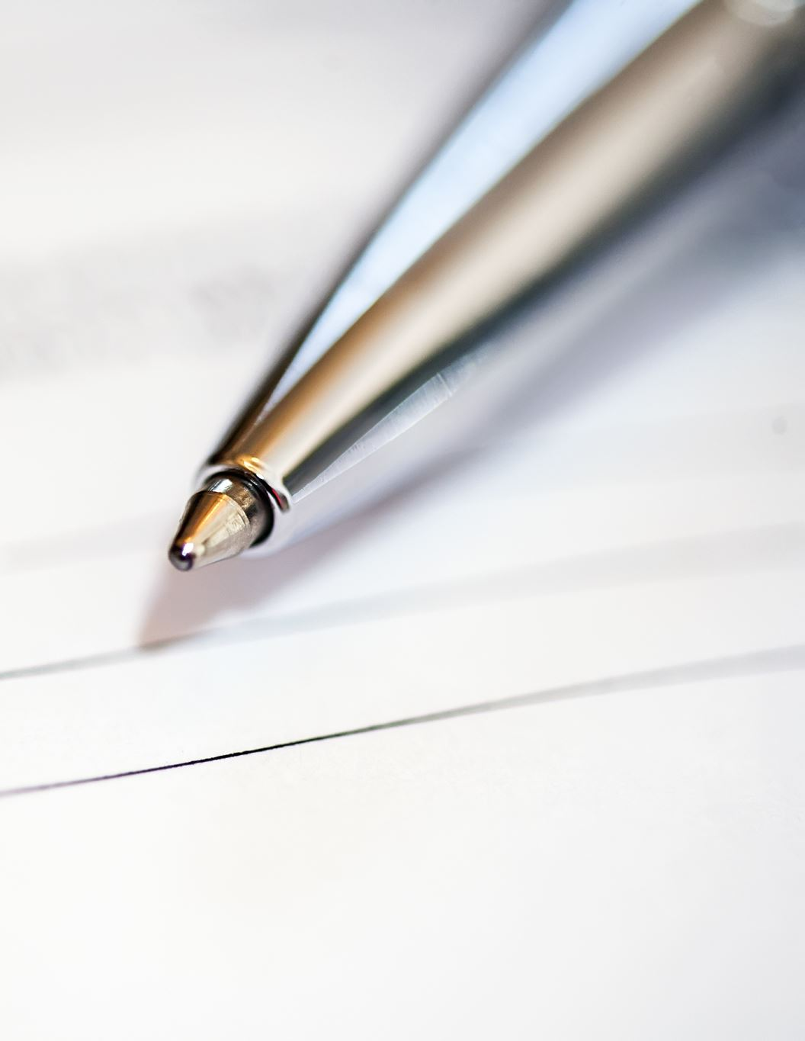
Writing support we used in this lesson:
Claim/Evidence/ Science Pre-writing Sheet
We know that – We saw that – Therefore argumentation organizer
Peer Check (content and simple grammar)

Slide 19
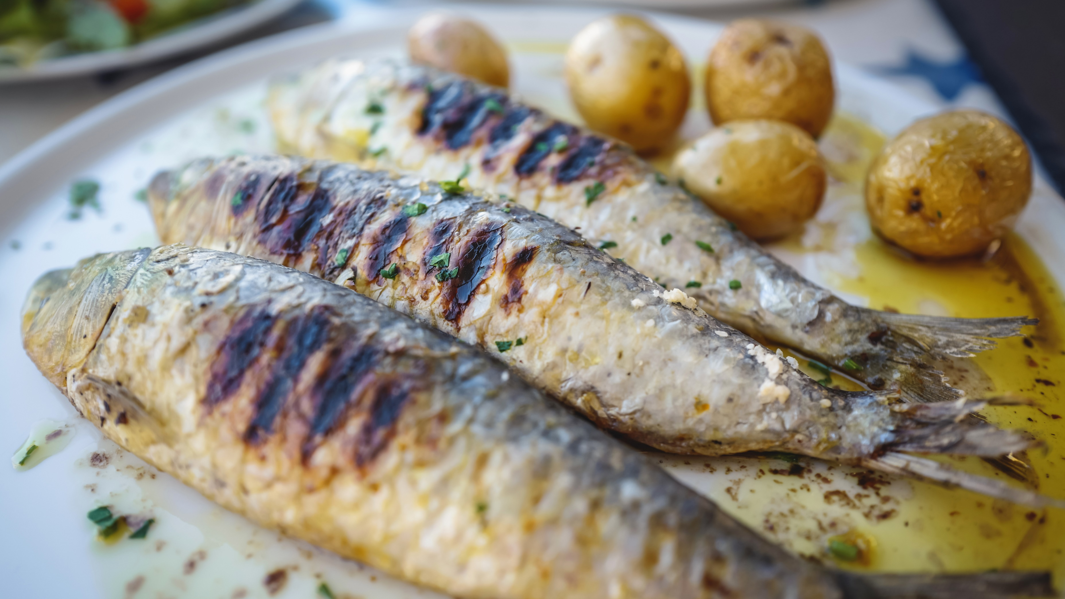
Biology Sample Lesson: Fish for Dinner?

Slide 20
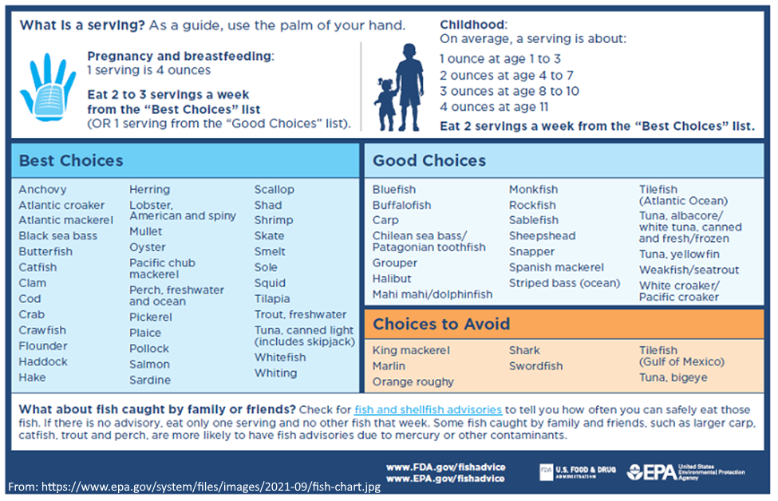

Slide 21
We know fish are extremely healthy from a nutrition perspective.
So why would we need to limit eating fish? Why some fish more than others?
Let’s brainstorm: What could the EPA be worried about?

Slide 22
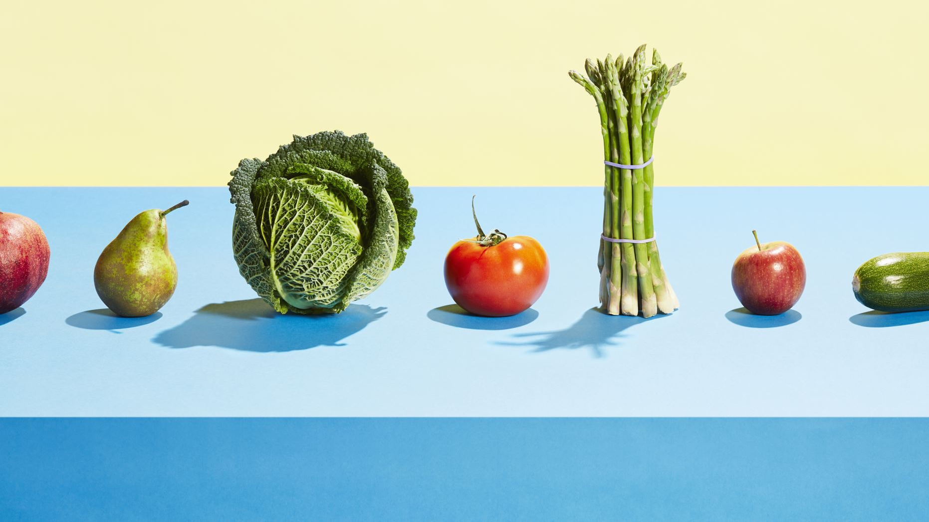
Imagine lesson on food chains/ food webs here.

Slide 23
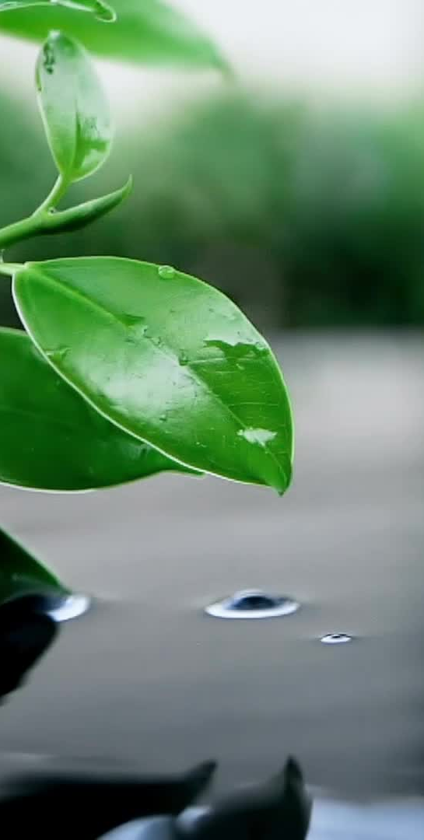
Here Comes Some Pollution…
Sprinkle 20 pollution stickers over your water plants. If pollution lands on the plant, the plant absorbs it! Remove the backing and stick it on the plant. Remove any pollution that does not stick to a plant.
Each small fish eats two water plants. Draw a line from a small fish to two plants that it eats. Count the number of dots on the plants. Stick that number of dots on the fish. Repeat for each small fish.
Each large fish eats two small fish. Draw a line from the large fish to two small fish that it eats. Count the number of dots on the small fish. Stick that number of dots on the large fish. Repeat for the other large fish.
The eagle eats both large fish. Count the dots on both large fish. Stick that number of dots on the eagle.

Slide 24
The Mysterious Case of Disappearing Birds
In the mid-20th century, something strange was happening to birds across America. Eagles, pelicans, and other fish-eating birds were facing a crisis. Their eggs had shells so thin they would break before hatching. Many baby birds weren't surviving, and some bird populations were shrinking fast. Scientists were puzzled: what could be causing this widespread problem?
The culprit, they discovered, was a pesticide called DDT. But how could a chemical sprayed on crops or used to control mosquitoes affect birds that didn't even eat plants or insects? The answer lay in a process scientists call biomagnification.
What is Biomagnification?
Biomagnification happens when certain harmful chemicals become more concentrated as they move up the food chain.
When DDT was sprayed on crops or in forests, it didn't stay put. It washed into rivers and lakes or settled onto plants. Small animals like insects or tiny water organisms called plankton absorbed the DDT. Once the chemical was in their bodies, it didn't break down. Instead, it stayed stored in their fat.
Not all pollutants build up in the body. Pollutants that that dissolve in water can be released in urine. It's the pollutants that are stored in fat, like DDT, that can cause problems.
When a bigger animal, like a fish, ate a bunch of those smaller creatures, it absorbed all the DDT from the prey. Then, if an even larger predator, like an eagle, ate the fish, the DDT built up even more in the eagle’s body. The higher you go in the food chain, the more DDT there was in each animal.
By the time DDT reached the birds, it was much more concentrated than in the water - sometimes millions of times stronger!
Why It Matters
In 1972, the United States banned DDT. But biomagnification is still important to understand. Other pollutants can build up in the food chain too, affecting wildlife and humans. Because of biomagnification, chemicals used on land can cause big problems for animals in water and even in the air.
(Writing assisted by AI: Gemini, Chat GPT, and Perplexity)

Slide 25
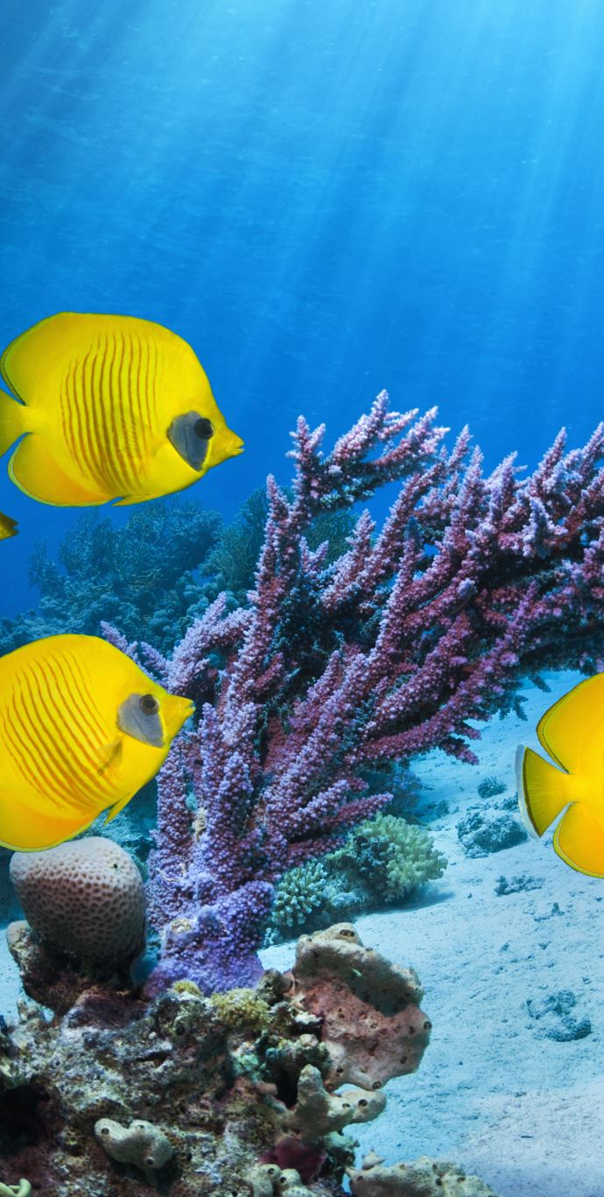
Fish for Dinner?
Compare the Pacific Ocean food web to the list of fish recommended by the EPA.
Why are some of the fish more unsafe than others? That is, what is it about a fish that makes it more likely to be on the "choices to avoid" list rather than the "best choices" list?
In your answer, include at least 3 of the vocabulary words from our word wall. [or, include the words trophic level, food chain, and bioaccumulation]

Slide 26
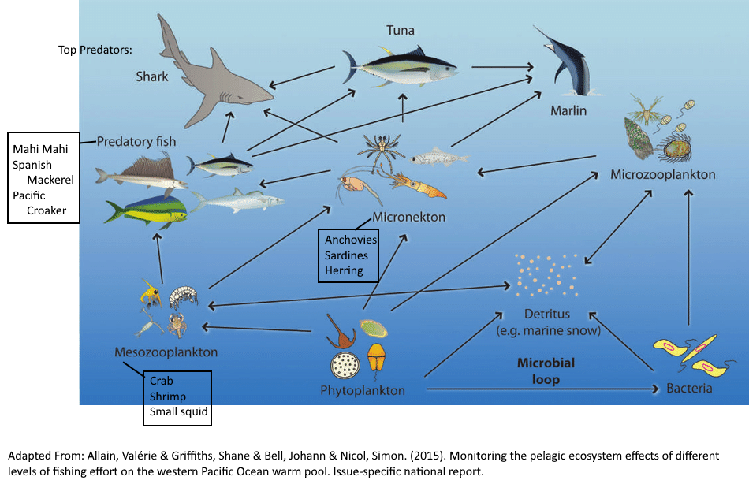

Slide 27
Writing Skill: Cause and Effect (sentence frames)
__(cause)___ causes ____(effect)_____by _______________ .
Since/Because/Due to ____(cause)_ , _______(effect) .
__(effect) _____, since/because/due to__(cause)_ .
Since the pollutant______________, ___________________________.
Since the pollutant is stored in fat, it stays in the body.

Slide 28
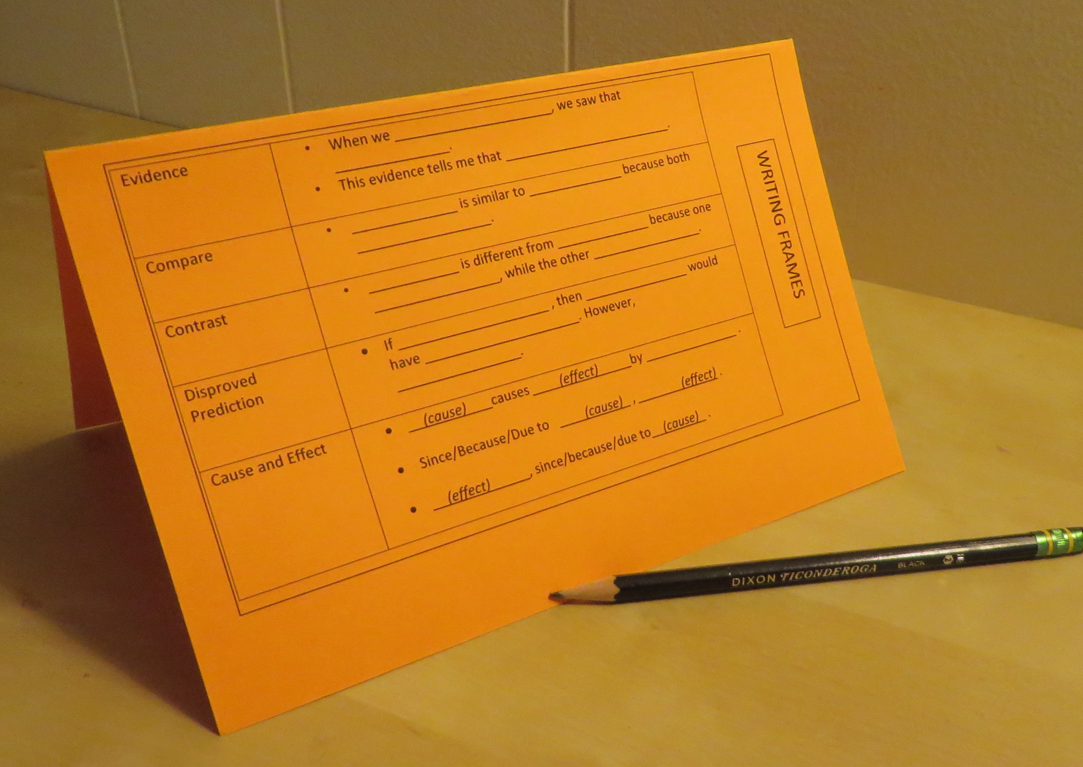
Writing frames for other tasks
Tents for Writing frames found here:
https://onceuponasciencebook.com/wp-content/uploads/2011/11/writing-frames.docx

Slide 29
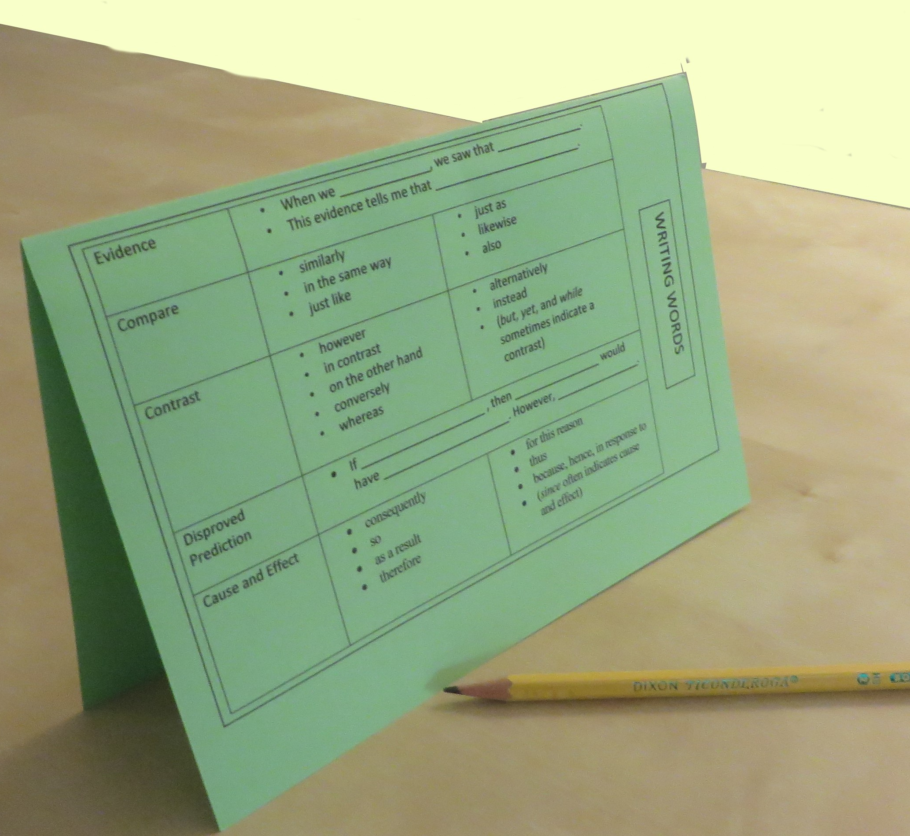
Writing words for other tasks
Tents for writing words found here
https://onceuponasciencebook.com/wp-content/uploads/2011/11/writing-words.docx

Slide 30
Give the writing assignment a try:
Compare the Pacific Ocean food web to the list of fish recommended by the EPA.
Why are some of the fish more unsafe than others? That is, what is it about a fish that makes it more likely to be on the "choices to avoid" list rather than the "best choices" list?
In your answer, include at least 3 of the vocabulary words from our word wall. [or, include the words trophic level, food chain, and bioaccumulation]
You may want to include the cause/ effect sentence we wrote earlier!

Slide 31
Two directions support could take from here:
Incomplete Responses
EXPAND
Blank Pages
Frame Entire Piece

Slide 32
E-X--P---A----N-----D
Add a “because” to your response.
Add a “for example” to your response.
Add a picture or diagram to your response. (Be sure to refer to it in words, with something like, “As you can see in the diagram…”)
Give this a try on your own response.

Slide 33
How could we frame this entire response? (students must help!)
The EPA ranks fish based on _________________________________.
Since this pollution is stored in fat, it stays in the body.
The fish that should be avoided are all ________________________.
First, the pollution _________________________________.
Then, _________________________. Then, _____________________.
This process is called ____________________________.

Slide 34
Writing support we used in this lesson
Sentence Frames and Writing Words
EXPAND protocol
Framing the entire piece together

Slide 35
Preparing Your Writing Assignment

Slide 36
Start with a good prompt.
Some types of questions that make good writing prompts:
They might explain an observation they made during the exploration. (ie, why did the lightbulb only light for some of the circuits?)
They might practice their new vocabulary to re-describe something they saw in the exploration. (ie, Describe what happened when you sprayed your mountain with water, using the words erosion and deposition.)
They might apply their knowledge to a new situation. (ie, Suppose a toy man fell off a boat off the coast of Savannah. Where would you expect it to go and why?)
They might propose an engineering solution. (ie, See this thing I built…I’m losing too much energy at this spot. Propose a way to reduce how much energy is getting used up there and explain why it would help.)

Slide 37
Write your own response.
If you have a hard time writing a good response, revisit the question. Is it clear?
Think about the depth of response you are looking for. Use pre-writing questions or activities to focus them on the desired ideas.

Slide 38


Contact Me:
Thank you for your participation!
Session Evaluation
https://forms.gle/D9PcJw4b47xiHN9j7

Slide 39
