Slide 1
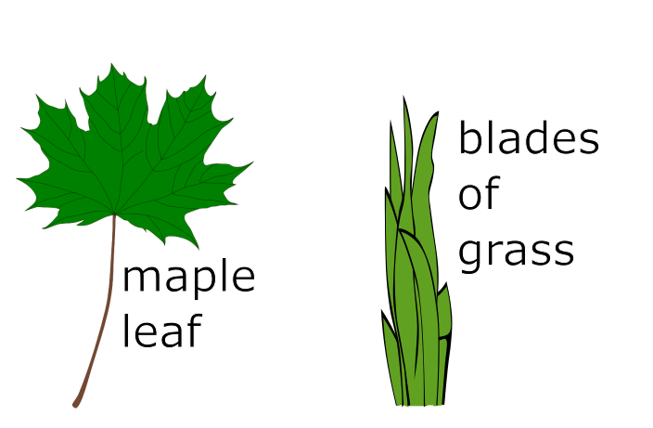
All Kinds of Leaves!
Plants have leaves. All kinds of leaves!
There are wide, pointy leaves.
There are straight, thin leaves.
1

Slide 2
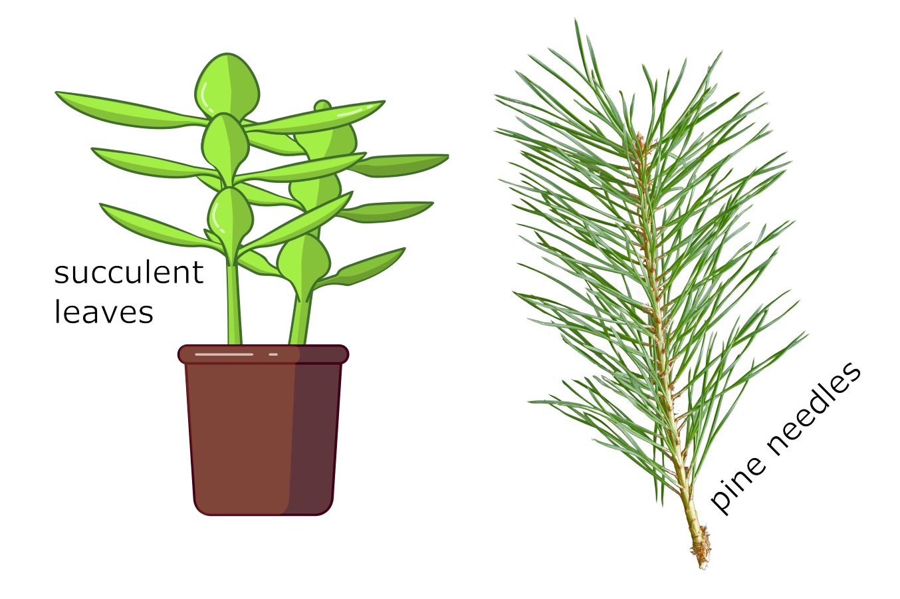
Leaves can be fat and squishy. Leaves can be long and skinny.
2

Slide 3
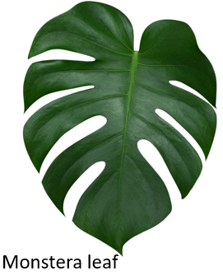
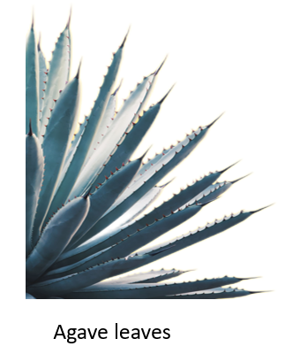
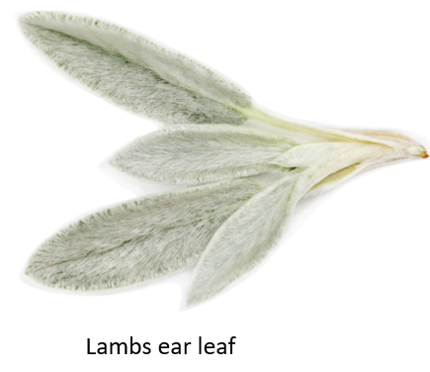
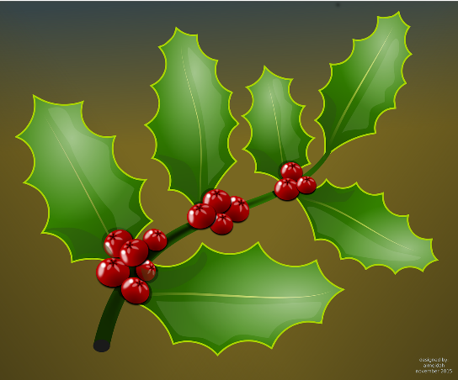
Some leaves feel slick and smooth across the top. Other leaves are fuzzy.
Some leaves are pointy. Other leaves are poky. Ouch!
Holly Leaves
Attribution: Venus Keawyoo, Monstera Plant Leaves Tropical Evergreen Vine Stock Photo 699071755 | Shutterstock
Attribution: Julia Sudnitskaya, Stachys Byzantina Woundwort Woolly Betony Lambs Stock Photo 318426080 | Shutterstock
Attribution:Taweesak Sriwannawit, Blackspined Agave Plant Blue Tone Color Stock Photo 2150215553 | Shutterstock
3

Slide 4
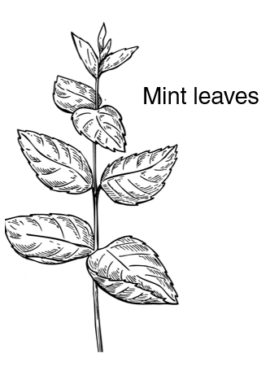
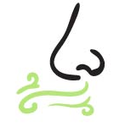
Some leaves smell minty. Some leaves smell earthy. Some leaves smell stinky. Yuck!
4
Attribution: Jimena Catalina Gayo, Hand Drawn Icons Representing Five Senses Stock Vector (Royalty Free) 446313718 | Shutterstock
Attribution: Epine, Mint Vector Drawing Set Isolated Mint Stock Vector (Royalty Free) 454445500 | Shutterstock

Slide 5
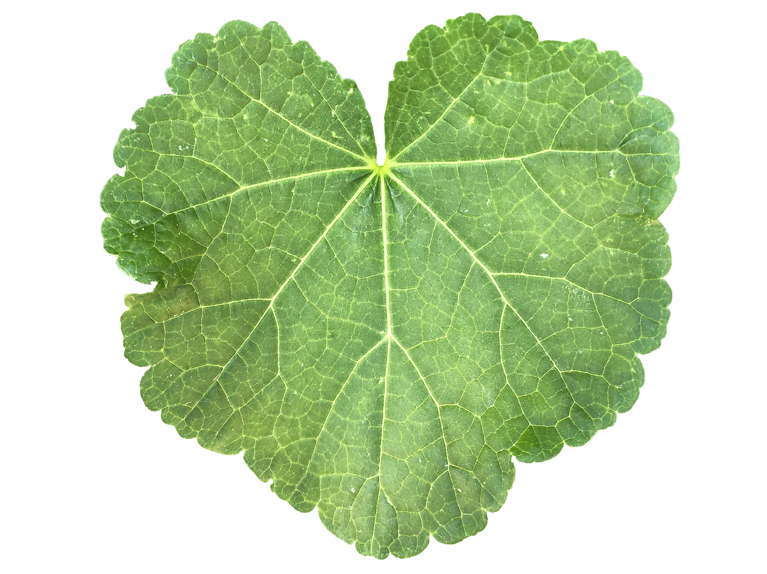
Some leaves have lines you can see and feel. The lines are called veins.
Veins carry food and water around the leaf.
5

Slide 6
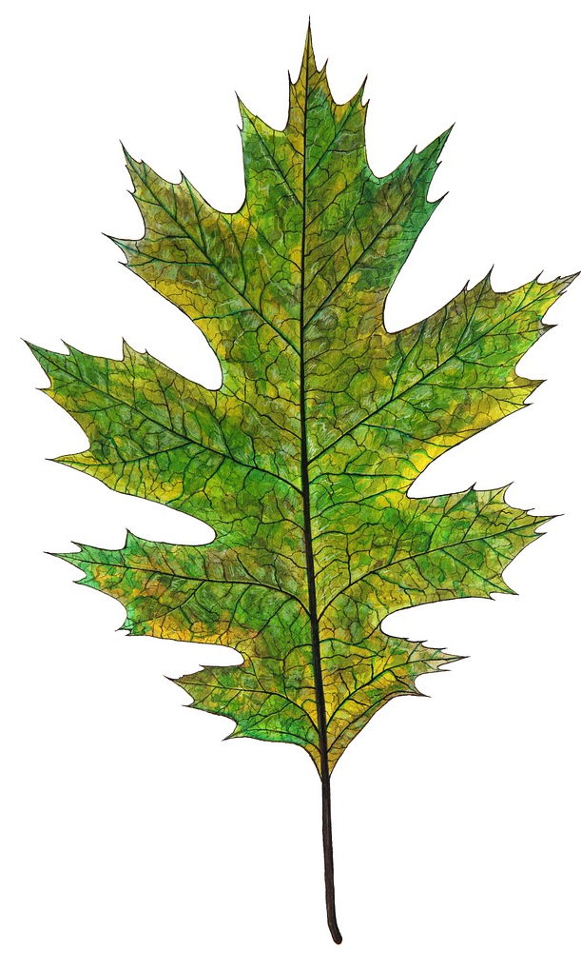
Some leaves have branching veins. Other leaves have straight veins. Some veins crisscross in messy patterns.
6

Slide 7

Most leaves are green, at least some of the time.
Some leaves stay green, green, green, all year long. Other leaves change color: red, yellow, orange and brown. They fall off for the winter.
7

Slide 8

In the spring, plants grow new, fresh leaves.
Little leaves, big leaves!
All kinds of leaves!
8

