Slide 1

Exploring
Static Electricity

Slide 2
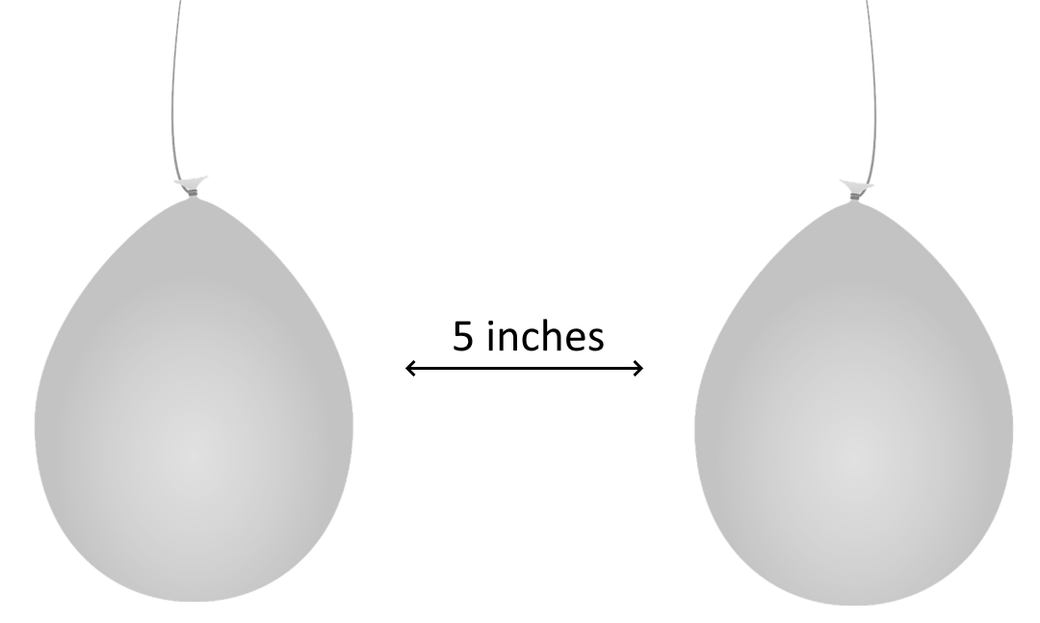
Let’s Explore with Balloons
Blow up two balloons. Tie a string around each one.
Hold the balloons about 5 inches apart.
Describe how your balloons are hanging: ____________________________
________________________________________________________

Slide 3

Let’s Explore with Balloons
?
3. These balloons do not have an electric charge. You can give them a charge by rubbing them with the wool cloth. Rub just one balloon with a wool cloth.
4. Hang them upside down again, about 5 inches apart.
Draw what happens in the space provided.

Slide 4
Let’s Explore with Balloons
?
5. Now rub both balloons with the wool cloth. Hang them upside down and 5 inches apart.
Draw what happens this time.

Slide 5
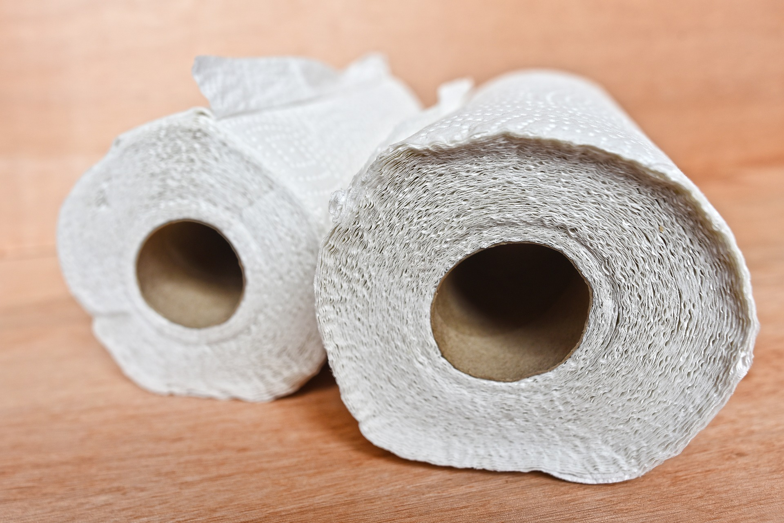
Rub both balloons all over with a paper towel. This will take the charge off the balloons.

Slide 6
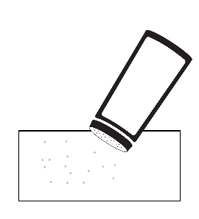
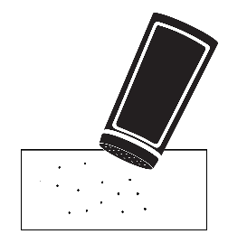

Balloons and other items
Pour a small amount of salt on a piece of paper towel, and a small amount of pepper on another paper towel.
Put the soda can or a piece of aluminum foil next to the paper towels, as shown.

Slide 7
Balloons and other items
Pour a small amount of salt on a piece of paper towel, and a small amount of pepper on another paper towel.
Put the soda can or a piece of aluminum foil next to the paper towels, as shown.

Slide 8
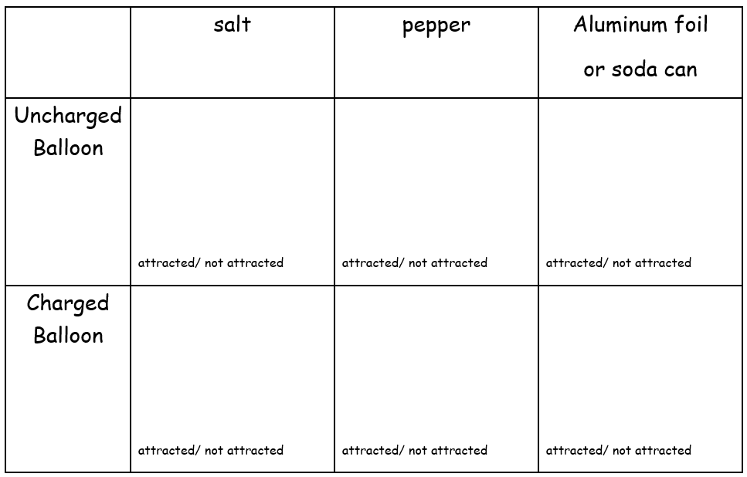
Balloons and other items
Hold one uncharged balloon a few inches over each item, one at a time. Describe what you see in the chart below and circle if the item is attracted to the balloon.
Charge a balloon by rubbing it with the wool cloth. Again, hold it over each item. Fill in the second line of the chart.
Did you hear anything when you held the charged balloon over the items?

Slide 9
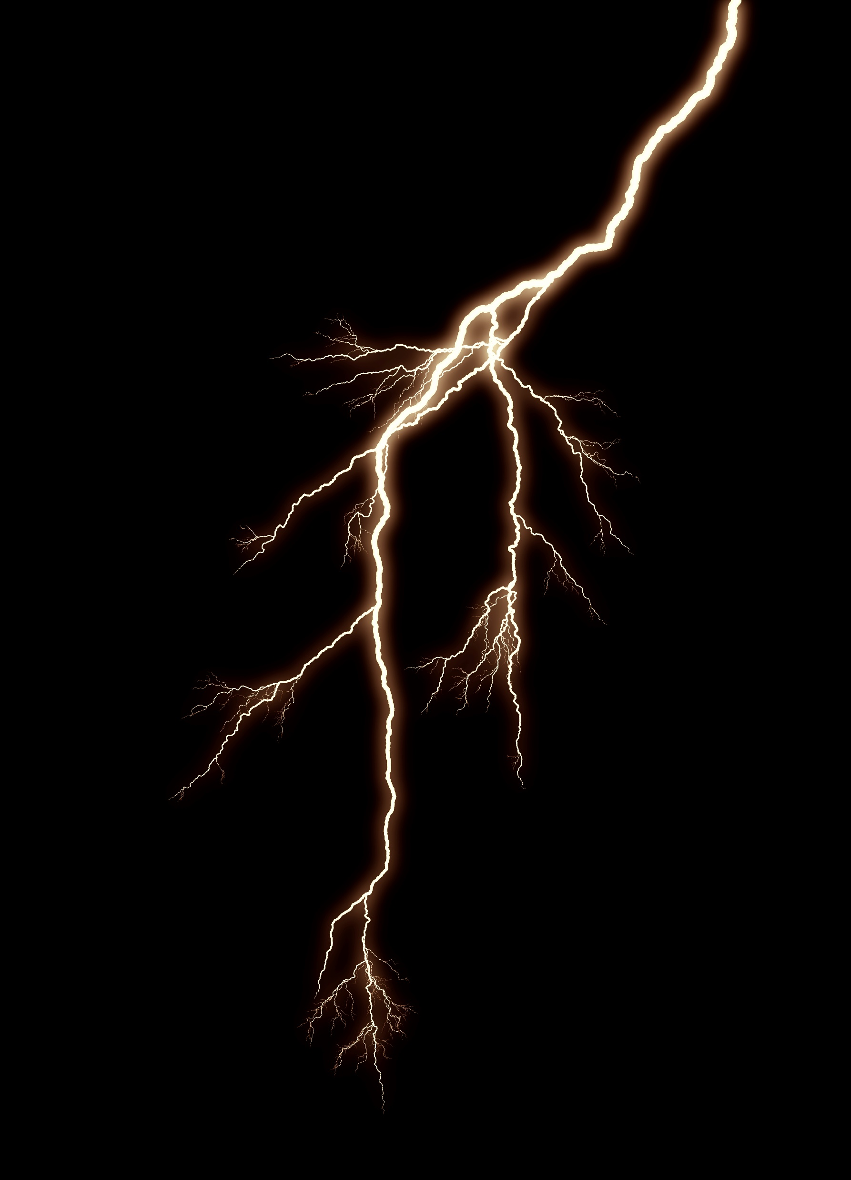
Let’s read an article that will help us explain what we saw with the balloons.
It’s Electric!

Slide 10



But first… a reading skill
Picturing as you Read
Science texts often describe situations. If we make a picture of them in our heads as we read, it helps us understand.

Slide 11
It’s Electric!
Have you ever grabbed a doorknob and felt a shock? Maybe you shook hands with a friend and she yelled, "Ouch! You shocked me!" When you feel a shock, it hurts, because energy is surging into your body. That energy is called electricity.

Slide 12
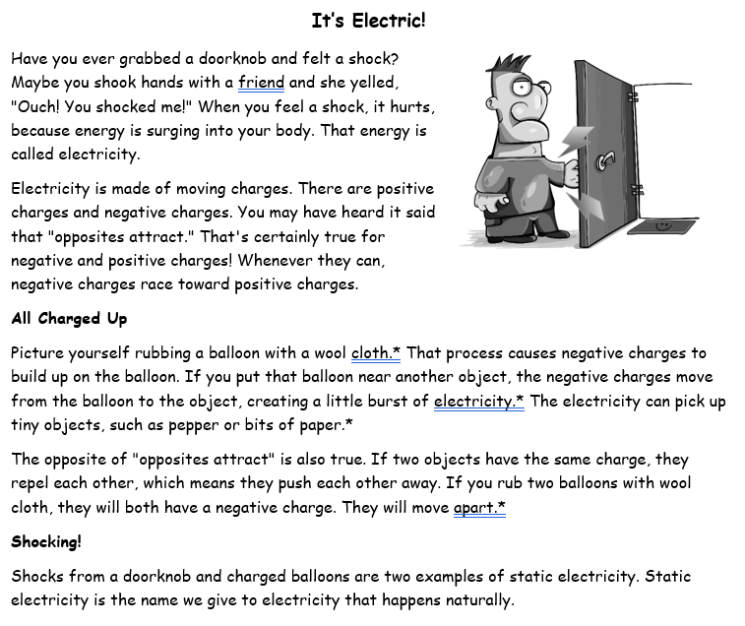
Whenever you see an asterisk (star) in the article, notice what picture you are forming in your mind.

Slide 13
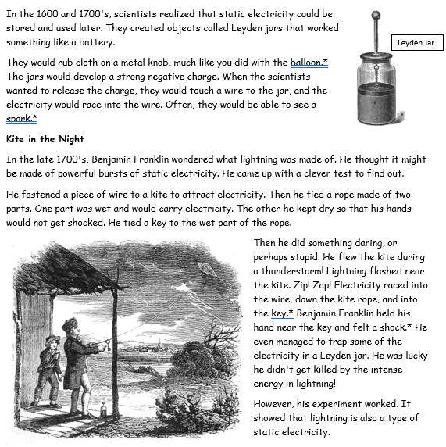

Slide 14
Writing Skill: Establishing the setting for a non-fiction narrative
Writing Prompt:
Describe a time that you experienced Static Electricity. It can be something that happened to you when you were younger, or it could be one of the experiences that you had in class working with the balloons. Describe where you were, what you did, what happened, and the science that explains why it happened. Use at least 4 of the vocabulary words from the word bank.
Reminder:
Readers will be trying to picture what is happening, just like you were trying to make pictures as you read the Static Electricity article!
Providing the setting for a narrative is an important part of helping your reader picture the event. The setting includes where something happened, when it happened, and what the environment was like. In a short piece like this one, letting the reader know who is present can also help create the scene.

Slide 15
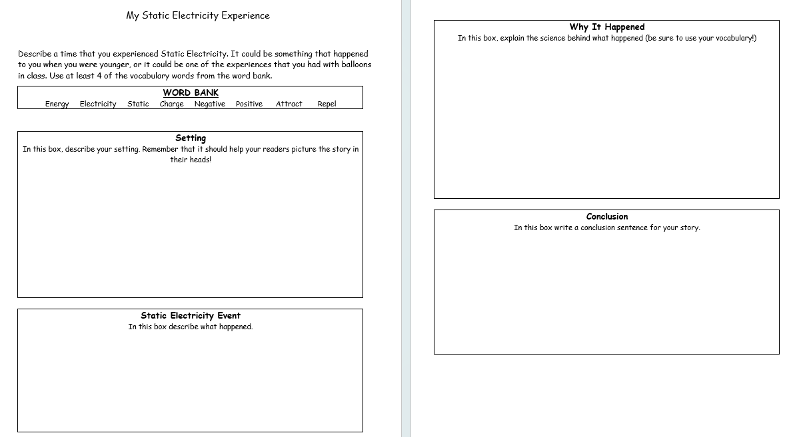

Slide 16


Lesson Structure
My static electricity experience…
Notes:
The students are hooked the moment they hold a wiggling worm. By the time the teacher turns to the book, the students are eager to read, and primed to learn a new reading skill. When it comes time to write, they students are confident in their knowledge and ready to share what they have figured out. Elementary students are naturally curious and want to learn how the world around them works. Science becomes the engine for the reading and writing train.

