Slide 1

Literacy Learning Cycles
Jodi Wheeler-Toppen, Ph.D.
Notes:
Before starting, set up Getting Dirty K Soil Reader on Word.

Slide 2

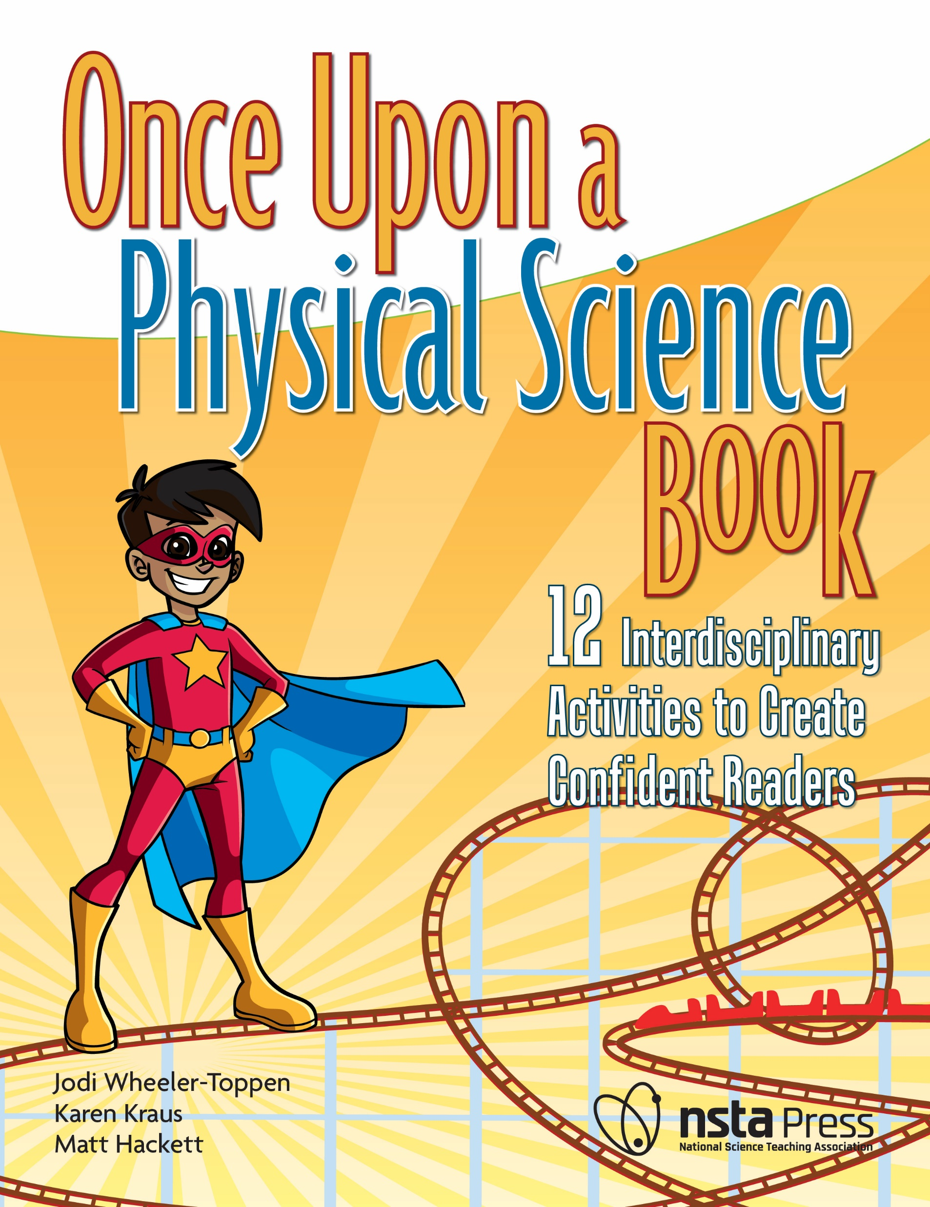

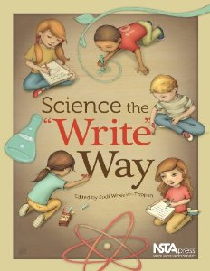
Who I Am and
How I Ended Up Here

Slide 3






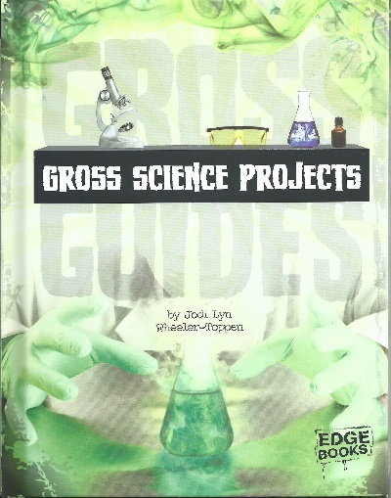








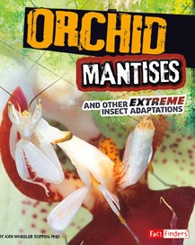



Slide 4


Connect with Me
Find Powerpoint here.
Also, sign up for newsletter!
@WheelerToppen

Slide 5
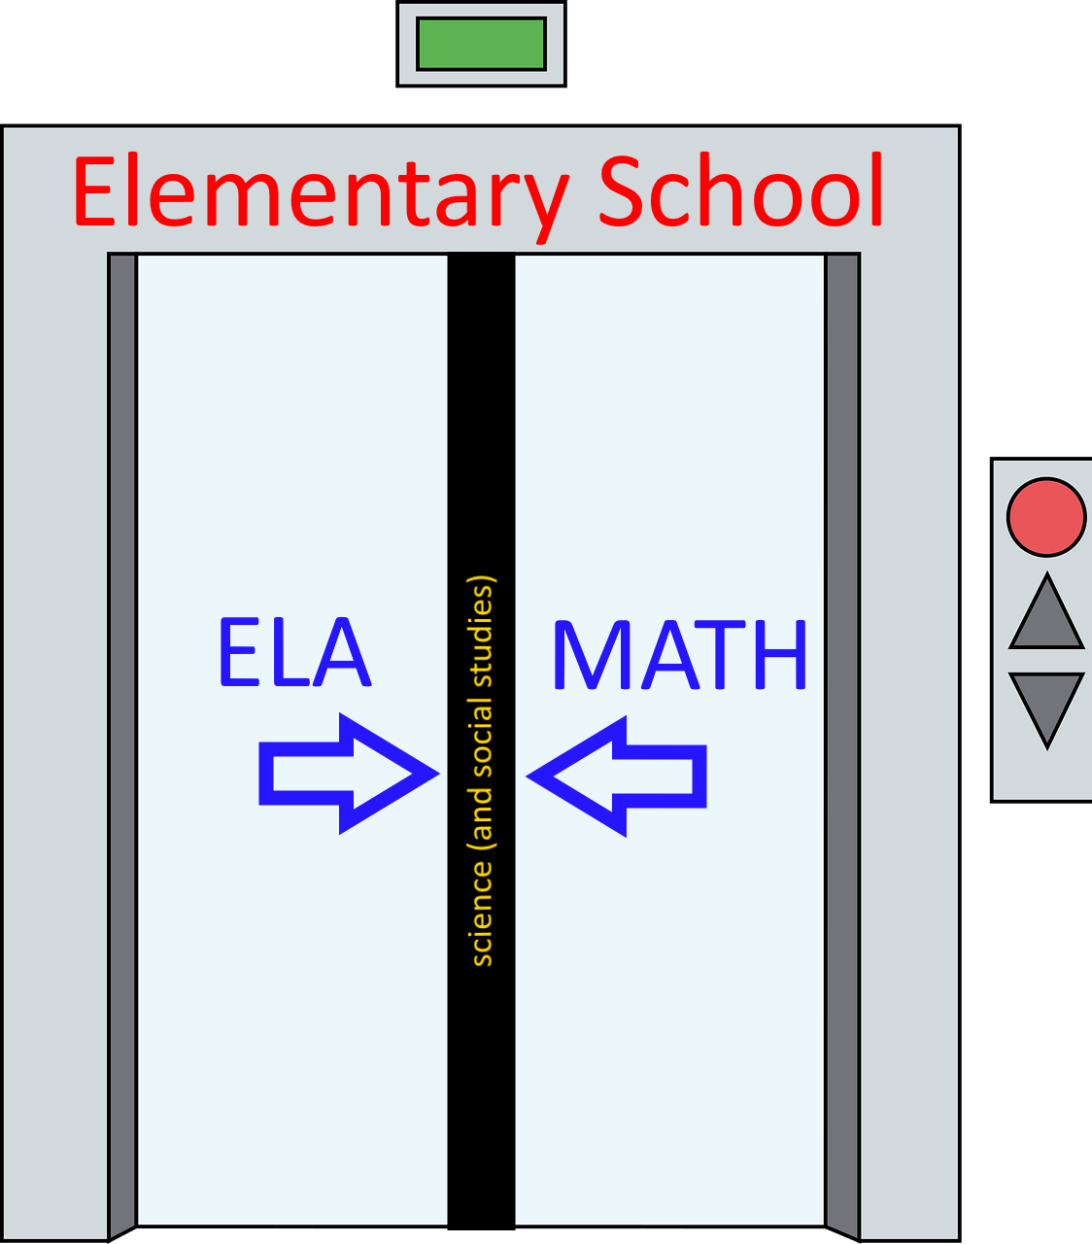
GA DOE:
Literacy and Science Tasks

Slide 6
Share with me:
What grades do we have represented?
Why are you here? What are you hoping for?

Slide 7
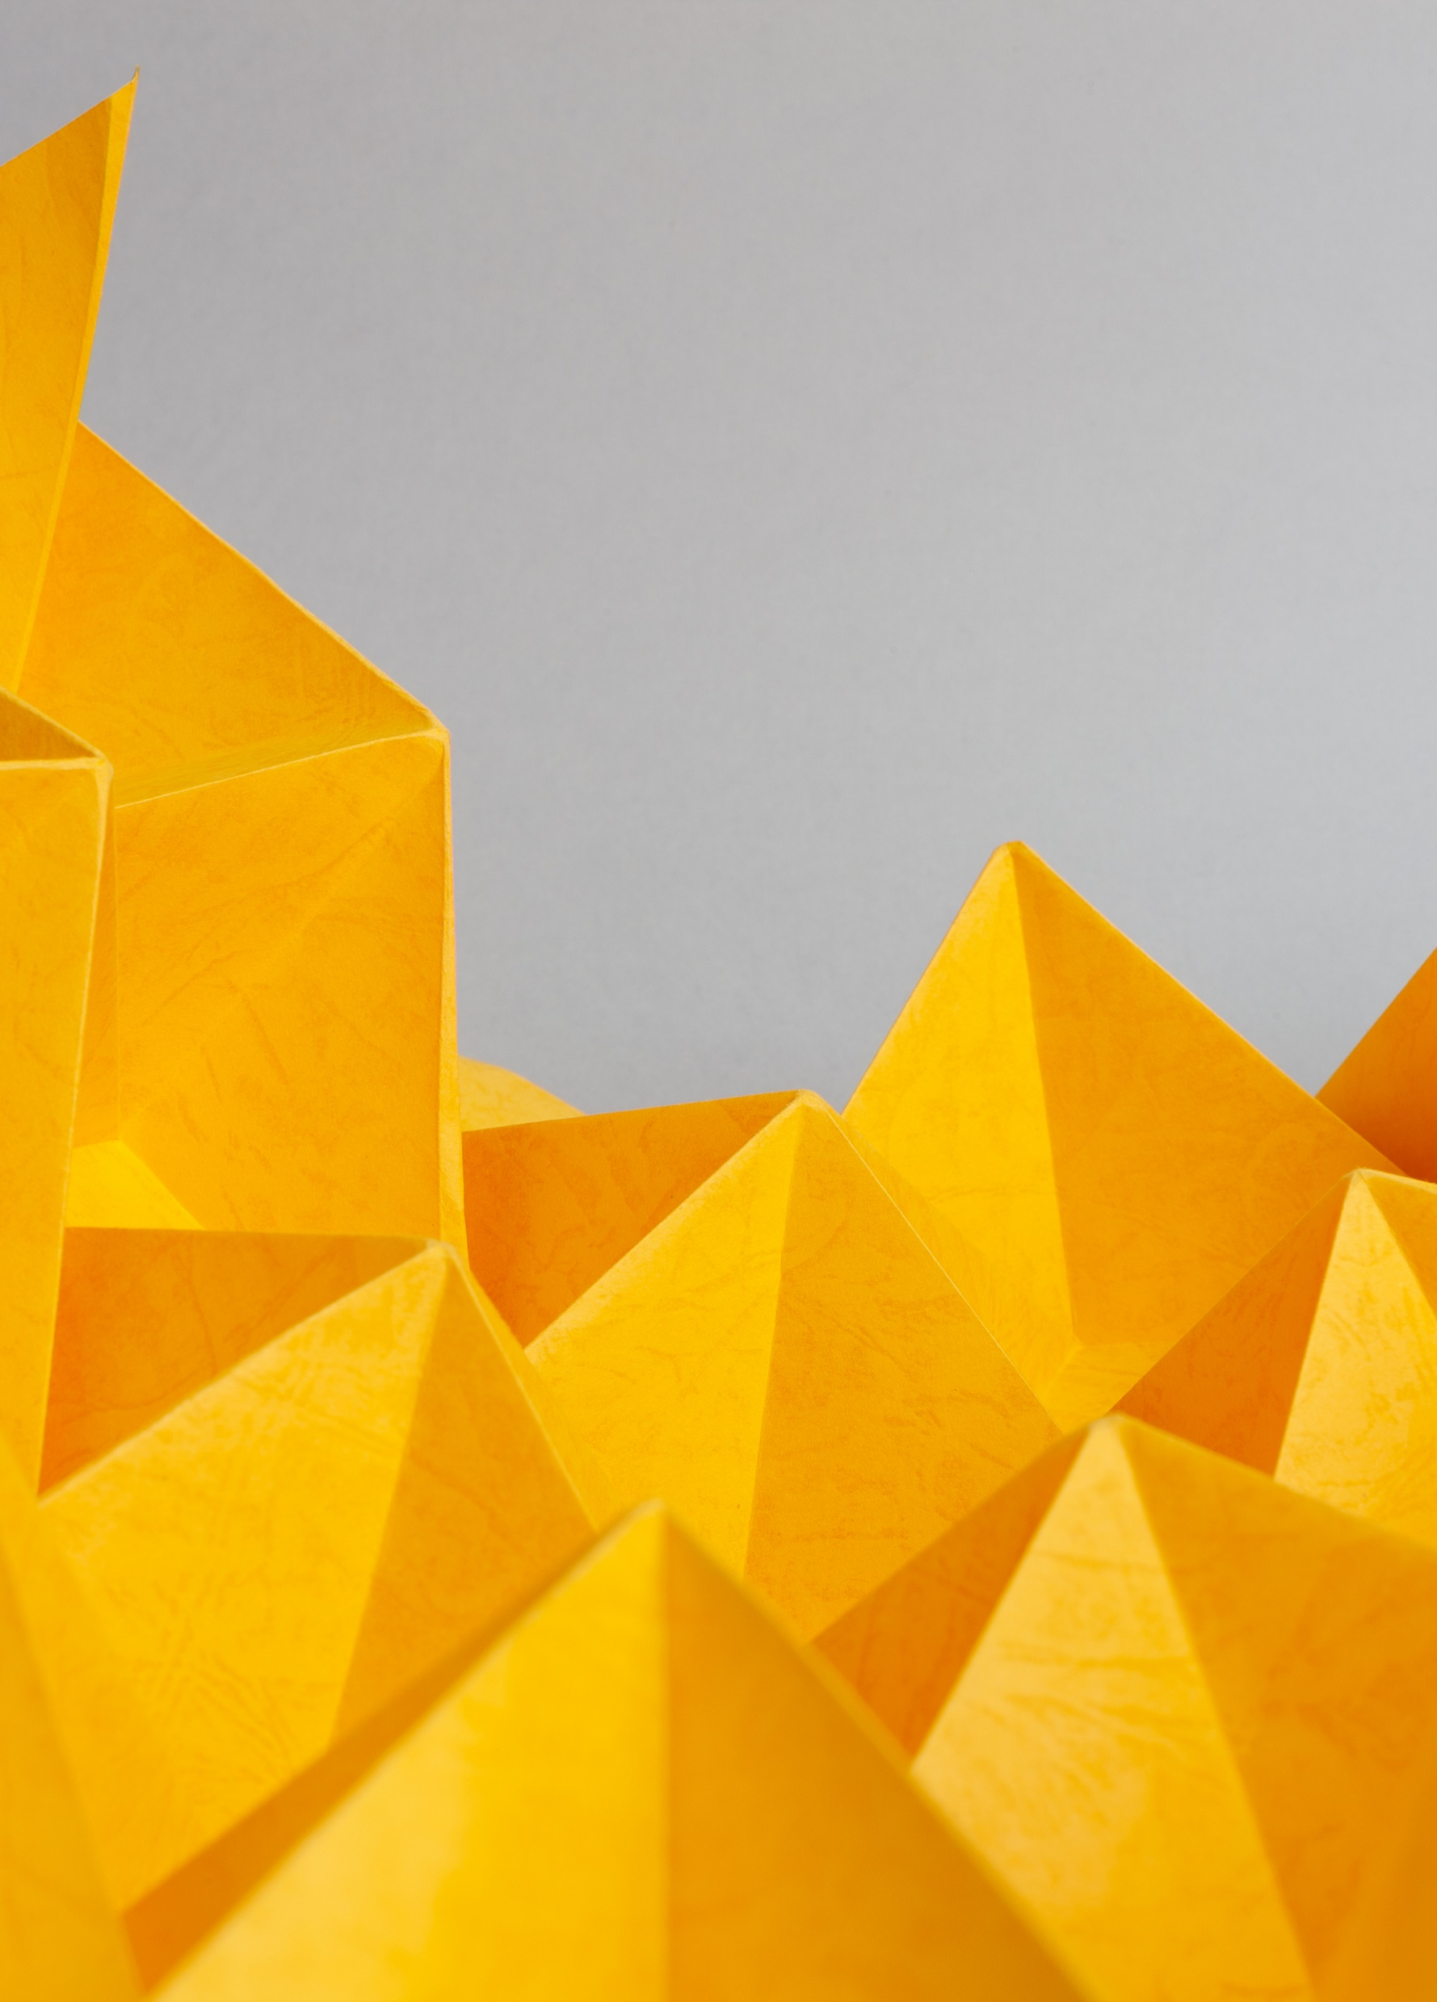
Agenda
Try a sample lesson together
Talk about structure and materials
Grade level groups to explore sample lesson for your grade
What did your group find?
Getting and using this material/ what if it doesn’t work with my reading curriculum?

Slide 8
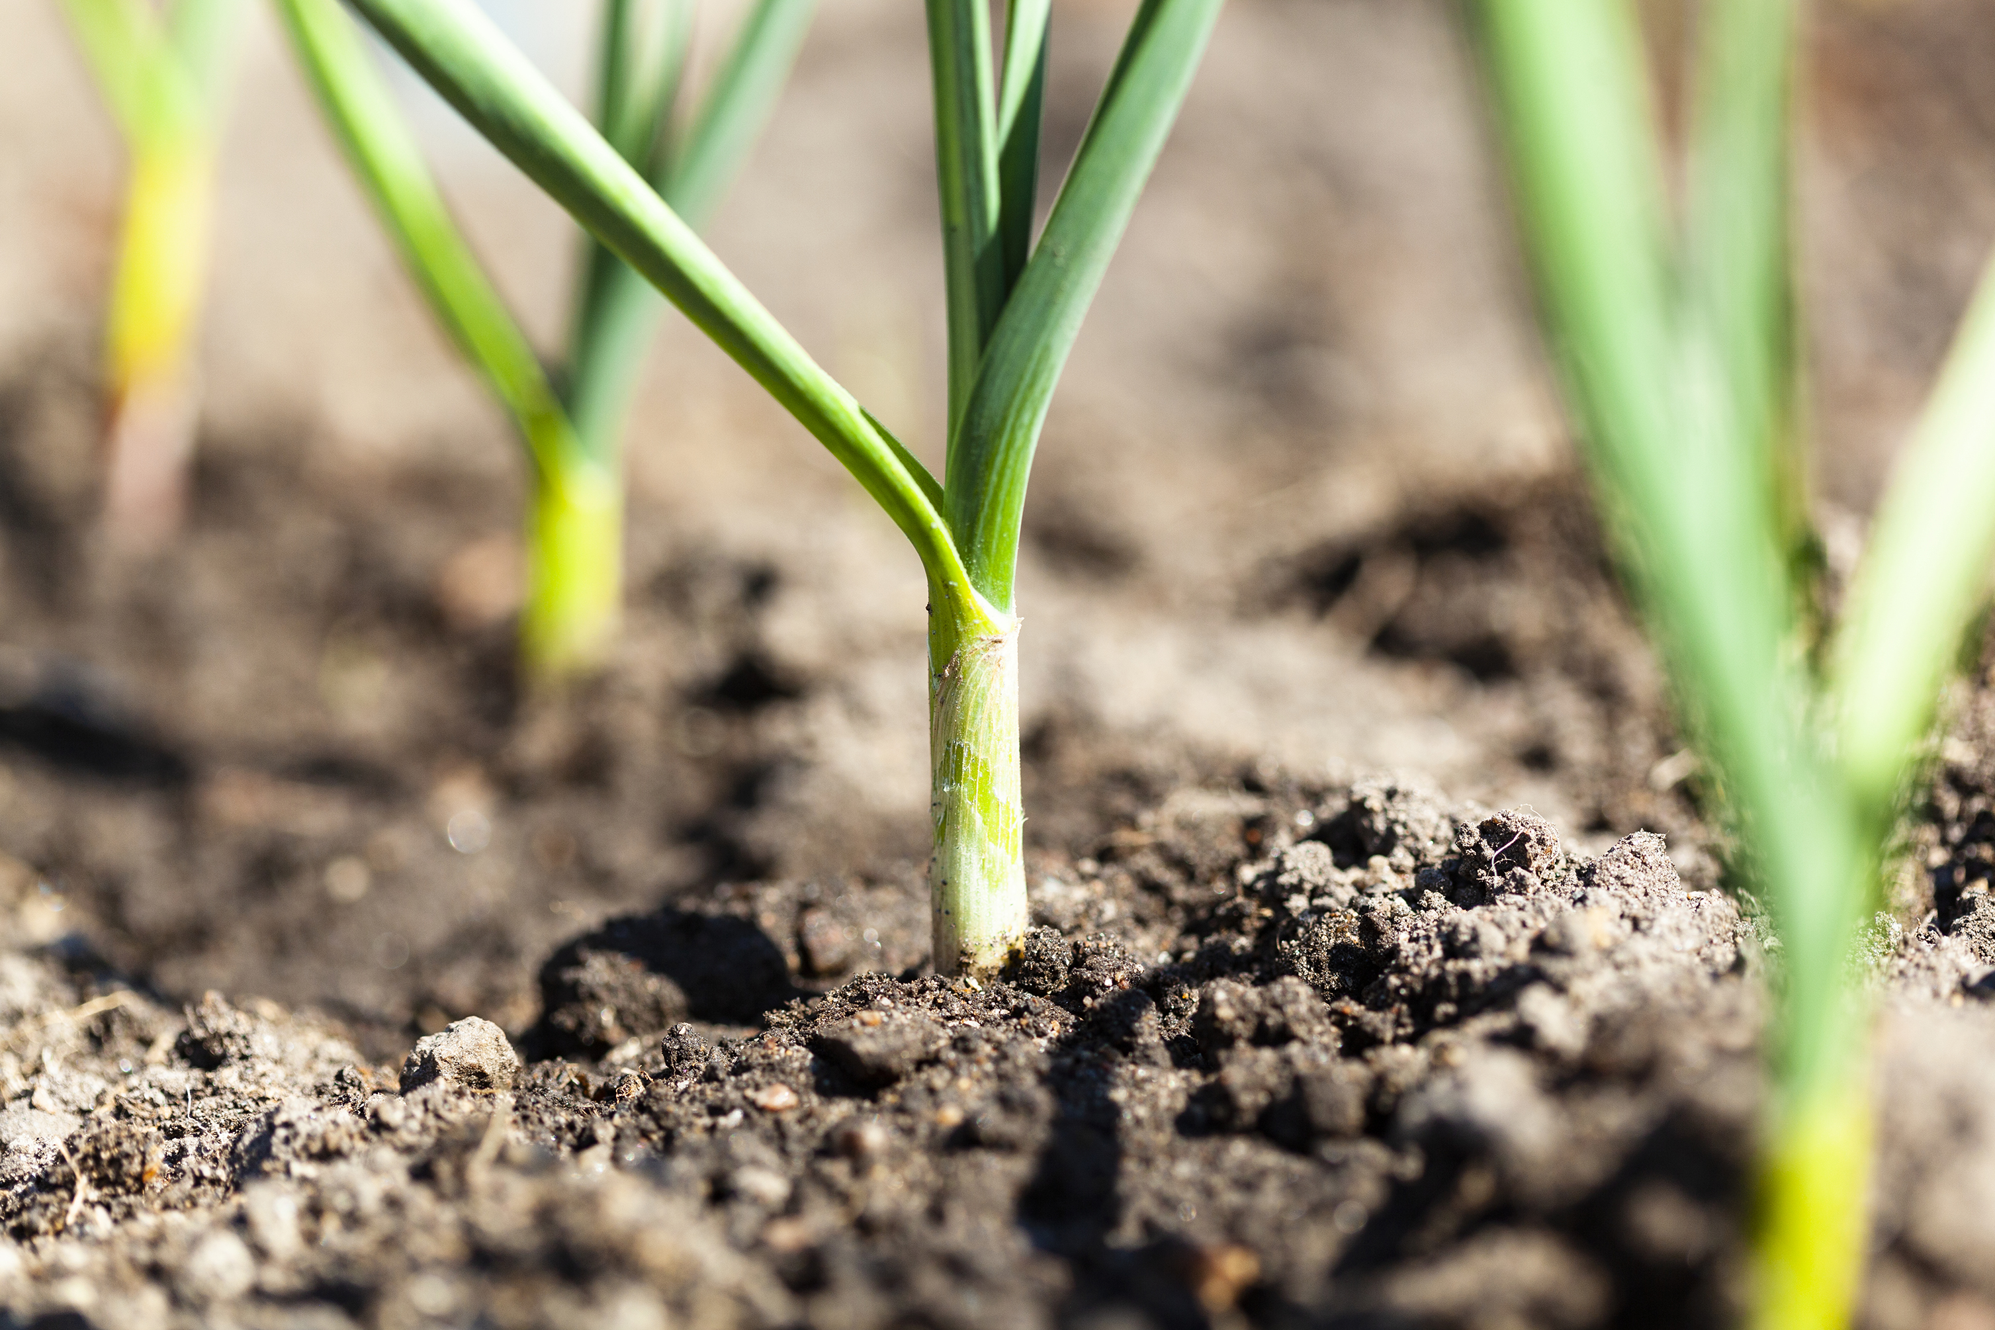
Sample Lesson: What’s in my dirt?
https://inspire.gadoe.org/lesson/4399

Slide 9
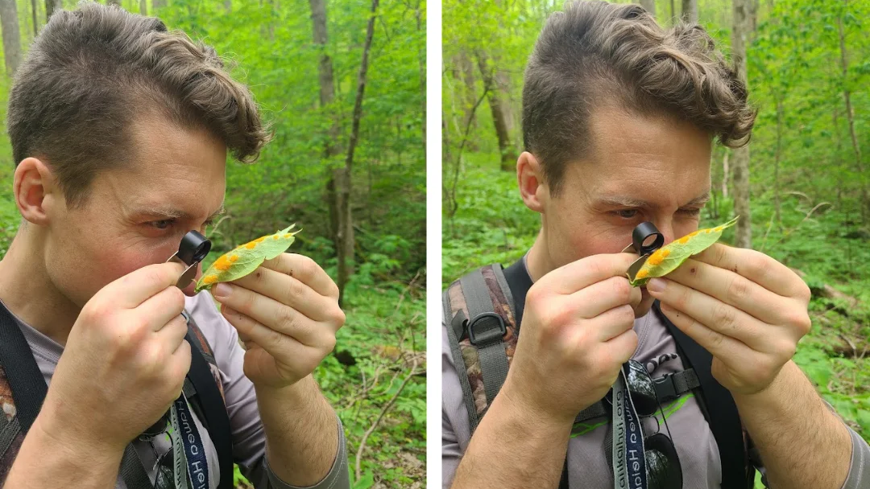
Using a Hand Lens (https://guloinnature.com)

Slide 10
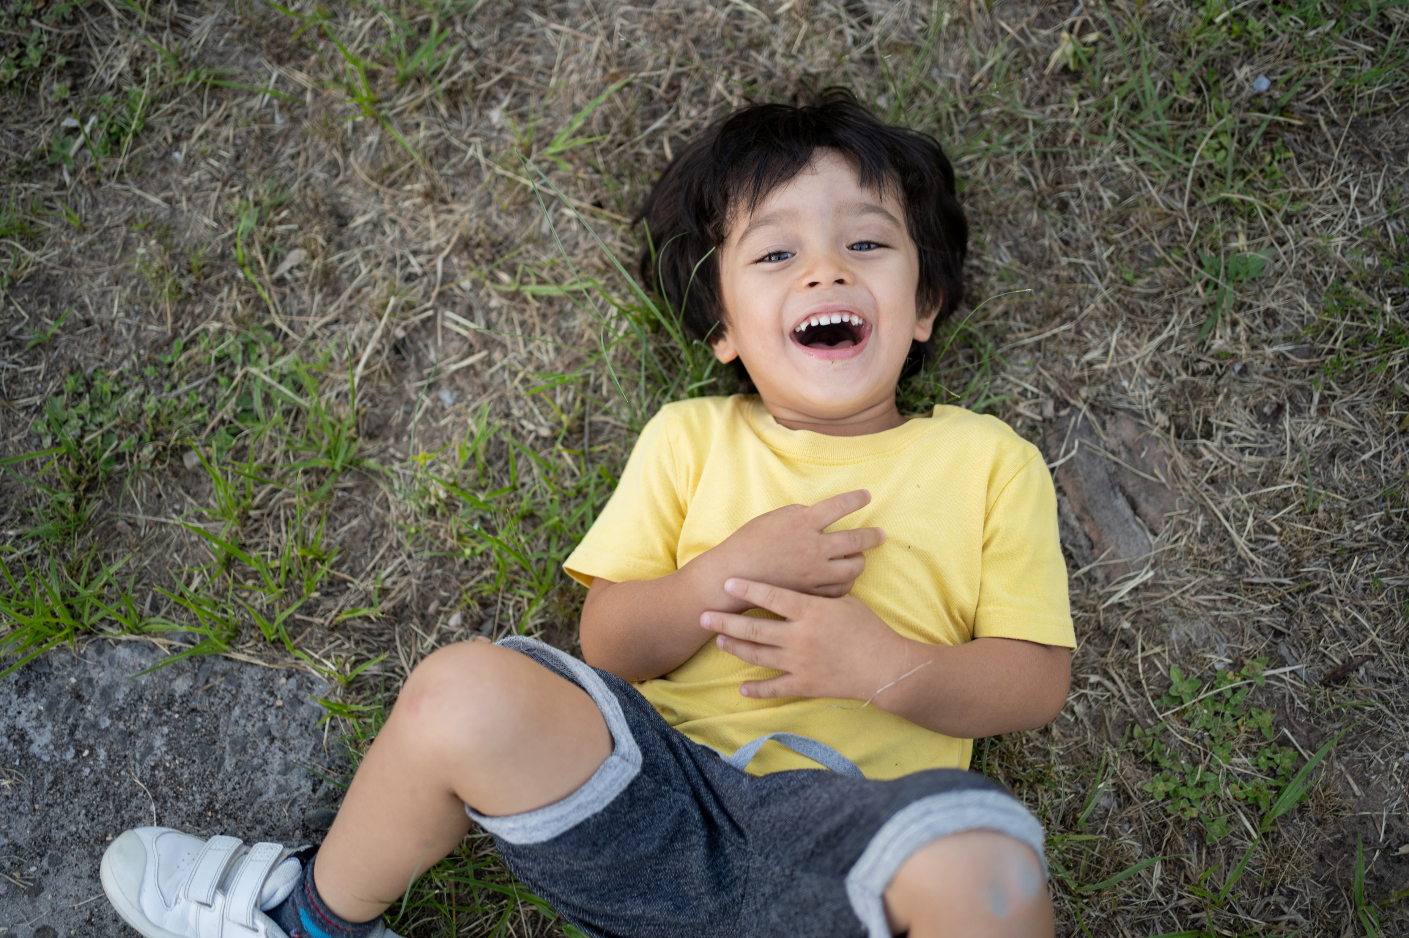
Explore your dirt!
Move it around, using your tools. Look at it closely.
What do you notice?
Draw some of the little pieces. Do you know what any of them are?

Slide 11
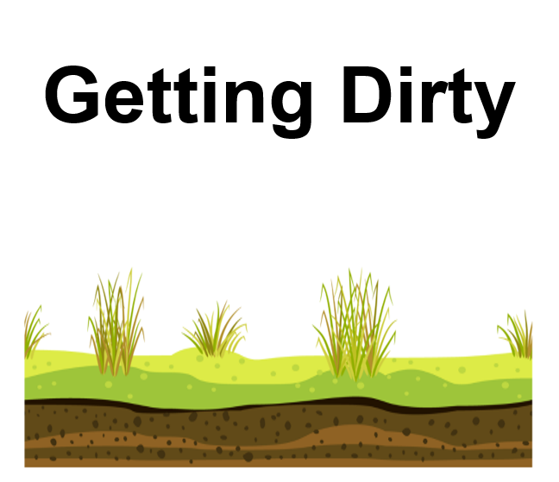
Let’s read a book together that will tell us more about our dirt.
It will even give us another name for dirt, so be listening for that!

Slide 12
Reading Skill: Main Idea
If you were going to pick one word that this book was about, what would it be?
Let’s see if we can make that into a sentence that gives the main idea of this book.

Slide 13
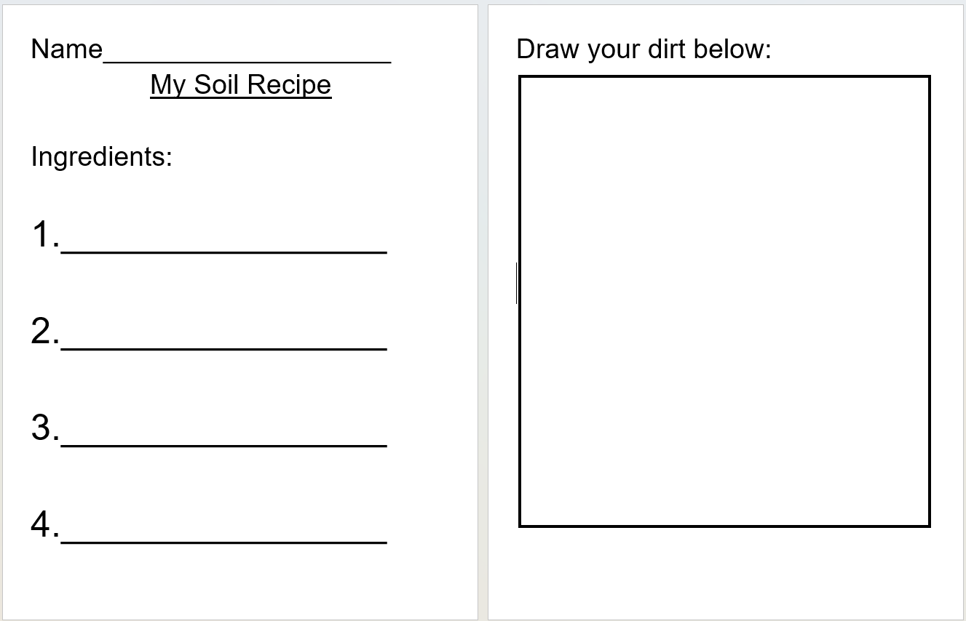
We have learned so many cool things about our soil! Let’s use writing to show what we learned.

Slide 14
Writing Skill: Support their current level
Tell me about this picture. Can you label it with the first letter sound you hear?
You are writing the word dirt! I’ll give you a hint. Dirt has four sounds. Can you listen for what sounds go after the d?
D _______ _______ ________
I see you have written a sentence here. We have been talking about what to put at the end of a sentence. Are you missing something?

Slide 15
Observations on this sample lesson?

Slide 16

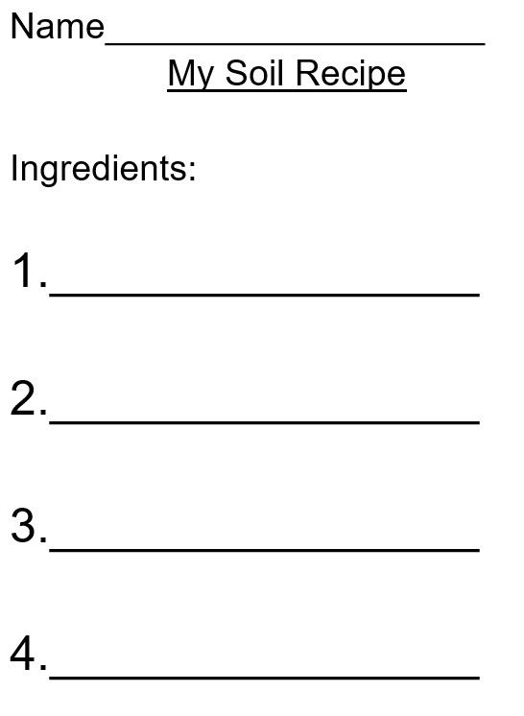


Lesson Structure
Notes:
The students are hooked the moment they hold a wiggling worm. By the time the teacher turns to the book, the students are eager to read, and primed to learn a new reading skill. When it comes time to write, they students are confident in their knowledge and ready to share what they have figured out. Elementary students are naturally curious and want to learn how the world around them works. Science becomes the engine for the reading and writing train.

Slide 17
Why start with the activity before the reading?

Slide 18
Somerset Draw with Durham Hands Notts the Title
After bowling the home side out for 320, Somerset were left needing 181 from 17 overs to guarantee the title. But, at 48-3, the chase was abandoned at Chester-le-Street and a draw agreed.
Fired-up Notts then took the three Lancashire wickets they required at Old Trafford to pick up a sixth bonus point and break Somerset hearts.
Eventually, Trego had Scott Rushworth caught behind and Benkenstein was caught at slip by skipper Marcus Trescothick off Charl Willoughby to set up the Somerset chase.
They went to the crease not knowing if a draw would be good enough to hold off Notts and immediately lost Kieswetter, promoted up the order, when he was bowled by Somerset old boy Blackwell.

Slide 19
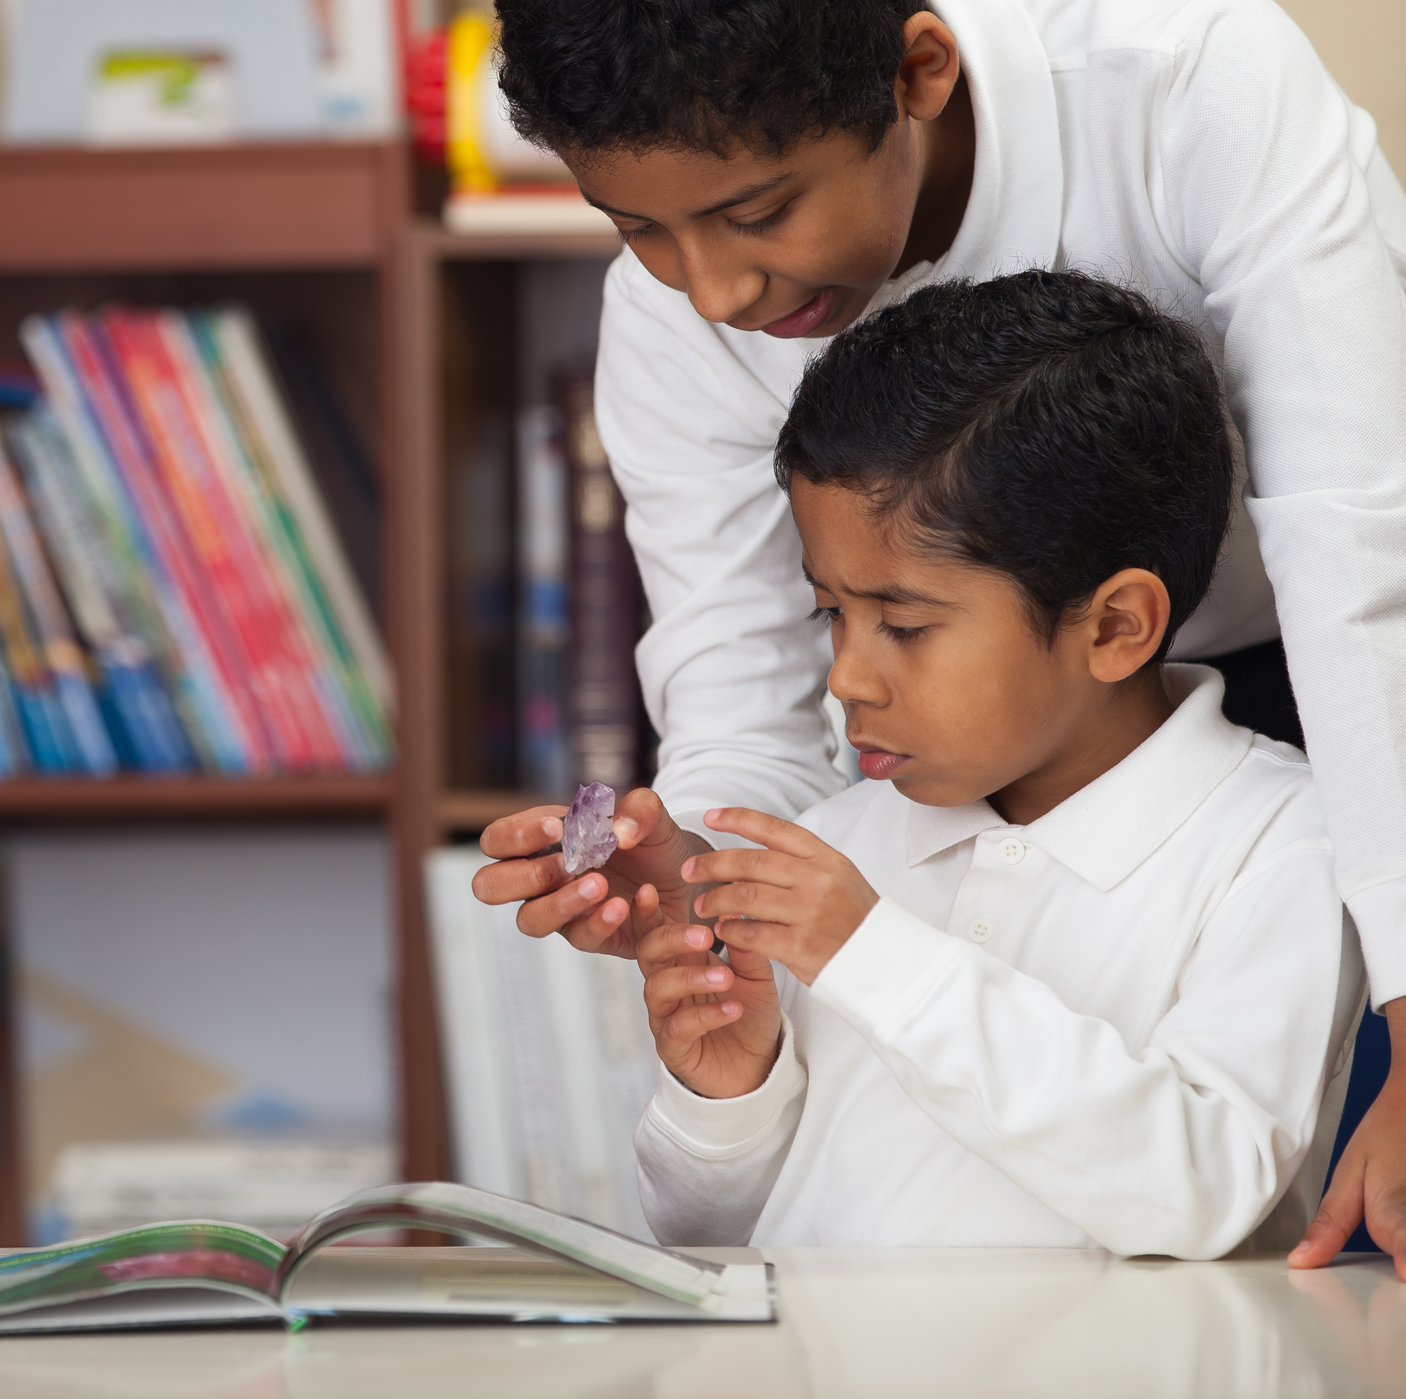
Start with hands-on science in order to:
Build background for understanding text
Help students approach text in “curiosity mode”
Engage more deeply with the text as it isn’t the “introduction” to the new ideas
Help students develop “something to say” by the time they need to write
ID 49771350 © Cmlndm | Dreamstime.com

Slide 20
Meeting ELA Standards
Writing Strategy
Reading Strategy
Notes:
The students are hooked the moment they hold a wiggling worm. By the time the teacher turns to the book, the students are eager to read, and primed to learn a new reading skill. When it comes time to write, they students are confident in their knowledge and ready to share what they have figured out. Elementary students are naturally curious and want to learn how the world around them works. Science becomes the engine for the reading and writing train.

Slide 21
Comments? Questions?

Slide 22
Science and Literacy Tasks from GaDOE
Grade | PDF Link | Editable Files (through Inspire)
K | Sink or Float | https://inspire.gadoe.org/lesson/4394
K | Living or Nonliving | https://inspire.gadoe.org/lesson/4396
K | Day and Night Sky | https://inspire.gadoe.org/lesson/1449
K | Soil | https://inspire.gadoe.org/lesson/4399
K | Grouping Organisms | https://inspire.gadoe.org/lesson/10063
1 | Plant & Animal Needs | https://inspire.gadoe.org/lesson/4391
1 | Weather | https://inspire.gadoe.org/lesson/4392
1 | Light | https://inspire.gadoe.org/lesson/1447
1 | Sound | https://inspire.gadoe.org/lesson/10073
1 | Magnets | https://inspire.gadoe.org/lesson/7491
1 | Everyday Magnets | https://inspire.gadoe.org/lesson/10072
2 | Shadows | https://inspire.gadoe.org/lesson/1450
2 | Stars | https://inspire.gadoe.org/lesson/10076
2 | Force and Motion | https://inspire.gadoe.org/lesson/10074
2 | Structures | https://inspire.gadoe.org/lesson/4401
2 | Life Cycles | https://inspire.gadoe.org/lesson/10075

Slide 23

Grade Level Lessons
Kindergarten: Grouping Organisms (Leaves)
1st Grade: Sound and Vibrations
2nd Grade: Stars

Slide 24

In your groups:
Read the directions and try out the science activity
Read the text (big readers/little readers/article style)
Look at the reading skill—would you use this one or a different one?
Check out the writing assignment. Think through what you would write as a student.
Look at the writing skill. Would you use this one or a different one?
If time, what would you alter to make this lesson work for your students?

Slide 25
Please return the copies to this folder when you are done.
I promise I will make editable versions of these available to you!

Slide 26

Share with us:
Did you see the system in place (activity; reading and skill; writing and skill)?
What did you like? What would you change?
Could you see yourself using a lesson like this?

Slide 27
The materials
LINK chart
Links to my edits
How to use the Inspire system (Good news, you can edit!!)

Slide 28
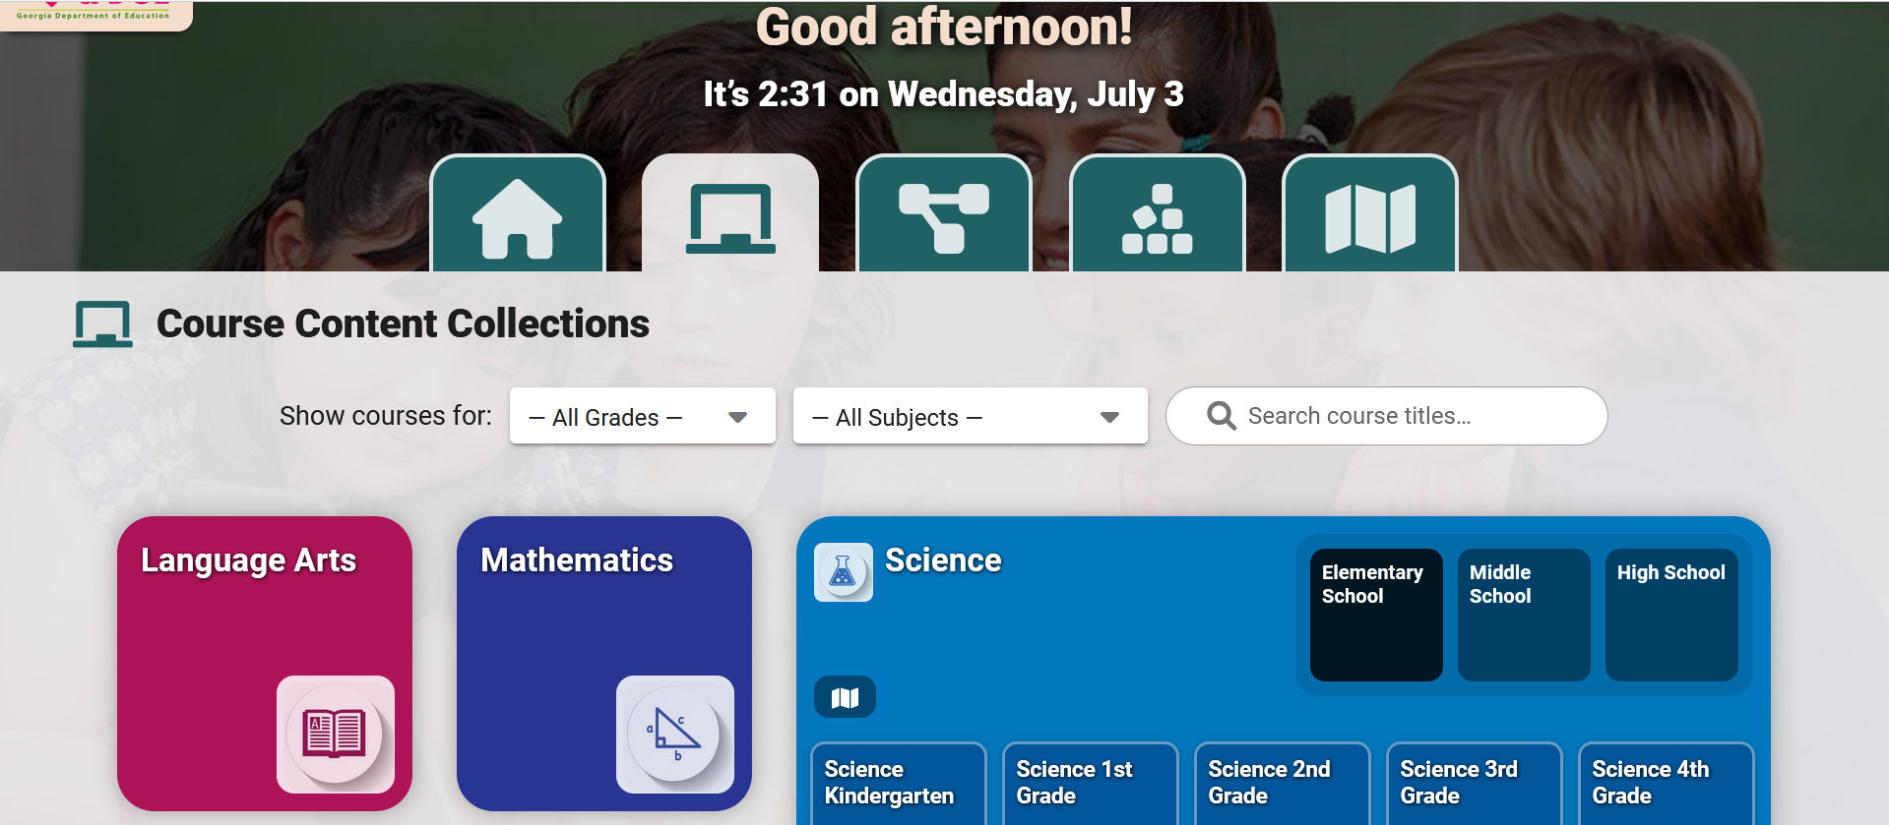
GA DOE Literacy-Based Science Tasks
Go to https://inspire.gadoe.org
Select “course content collections”

Slide 29
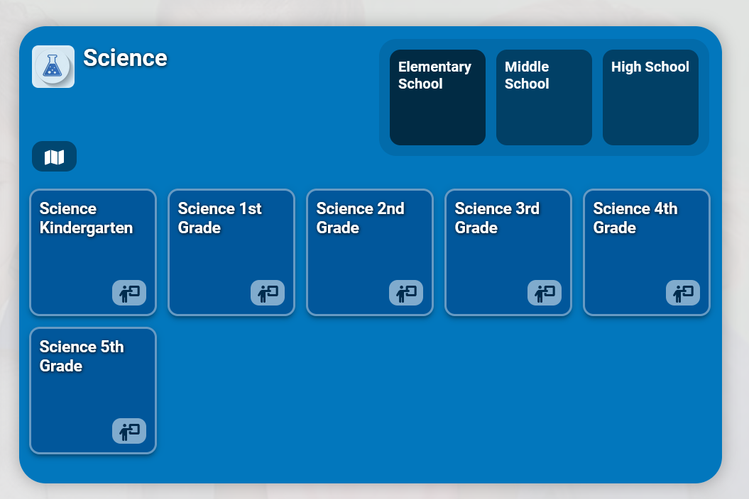
GA DOE Literacy-Based Science Tasks
Choose Science, elementary school
Click on your grade

Slide 30
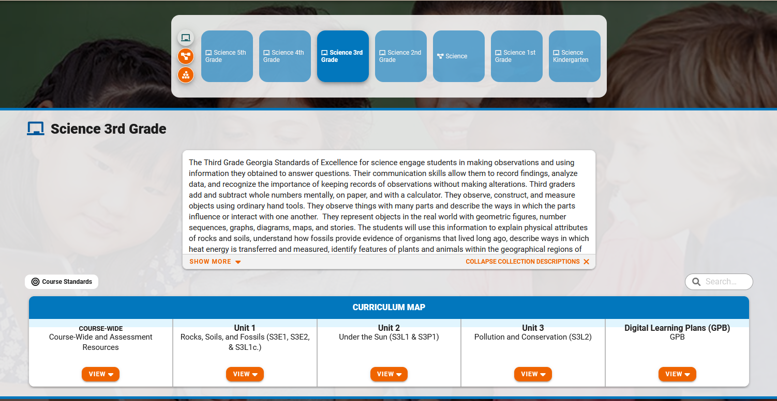
GA DOE Literacy-Based Science Tasks
Scroll down and select your unit

Slide 31
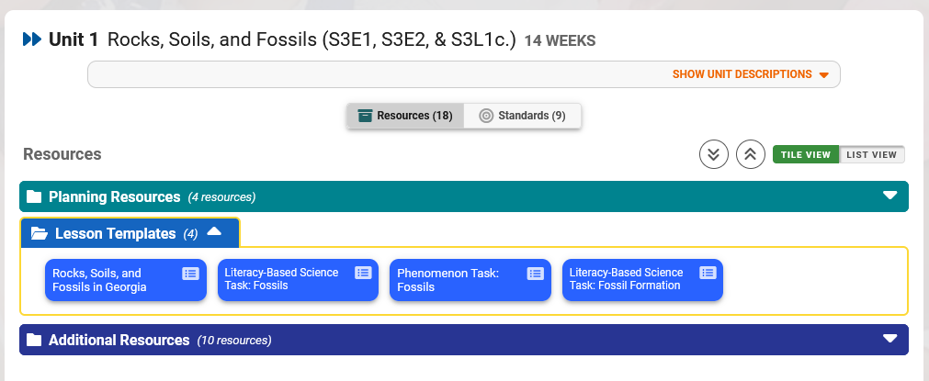
GA DOE Literacy-Based Science Tasks
Choose Lesson Templates
Look for lessons labeled ”Literacy-Based Science Task”

Slide 32
Or, use this cheat sheet with direct links
Grade | PDF Link | Editable Files (through Inspire)
K | Sink or Float | https://inspire.gadoe.org/lesson/4394
K | Living or Nonliving | https://inspire.gadoe.org/lesson/4396
K | Day and Night Sky | https://inspire.gadoe.org/lesson/1449
K | Soil | https://inspire.gadoe.org/lesson/4399
K | Grouping Organisms (leaves) | https://inspire.gadoe.org/lesson/10063
1 | Plant & Animal Needs | https://inspire.gadoe.org/lesson/4391
1 | Weather | https://inspire.gadoe.org/lesson/4392
1 | Light | https://inspire.gadoe.org/lesson/1447
1 | Sound | https://inspire.gadoe.org/lesson/10073
1 | Magnets | https://inspire.gadoe.org/lesson/7491
1 | Everyday Magnets | https://inspire.gadoe.org/lesson/10072
2 | Shadows | https://inspire.gadoe.org/lesson/1450
2 | Stars | https://inspire.gadoe.org/lesson/10076
2 | Force and Motion | https://inspire.gadoe.org/lesson/10074
2 | Structures | https://inspire.gadoe.org/lesson/4401
2 | Life Cycles | https://inspire.gadoe.org/lesson/10075

Slide 33
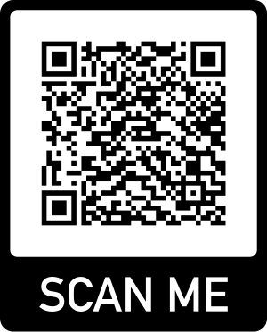
Word Files in these lessons are editable!
I updated several of them for this presentation—mostly the readings. You will find my edits (and a repeat of the cheat sheet) here:
https://onceuponasciencebook.com/2024/07/08/more-literacy-learning-cycles-for-elementary-science/

Slide 34
But this doesn’t match my reading curriculum!

Slide 35
Comments? Questions?

Slide 36
Connect with Me
Find Powerpoint here.
Also, sign up for newsletter!
@WheelerToppen

