Slide 1

Literacy Strategies for 5th Grade Science
Jodi Wheeler-Toppen, Ph.D.

Slide 2
Welcome!
Please help me by making a name plate.
Do we have anyone who was not here in the fall session?

Slide 3







Lesson Structure
What we made was…
vinegar
Notes:
The students are hooked the moment they hold a wiggling worm. By the time the teacher turns to the book, the students are eager to read, and primed to learn a new reading skill. When it comes time to write, they students are confident in their knowledge and ready to share what they have figured out. Elementary students are naturally curious and want to learn how the world around them works. Science becomes the engine for the reading and writing train.

Slide 4
More Complex Literacy Learning Cycle
Reading Strategy
Writing Strategy
Notes:
The students are hooked the moment they hold a wiggling worm. By the time the teacher turns to the book, the students are eager to read, and primed to learn a new reading skill. When it comes time to write, they students are confident in their knowledge and ready to share what they have figured out. Elementary students are naturally curious and want to learn how the world around them works. Science becomes the engine for the reading and writing train.

Slide 5
Last time: Reflection Point 4
Action Items. List specific things you want to do to follow-up on things you learned/ thought about today.
Plan to put this list somewhere where you will see it and act on those items.
Challenge. We will have a follow-up gathering in January. Between now and then, try at least one time to teach using a literacy learning cycle (with or without a specific reading or writing skill).
Take a few minutes now to think about what topic you might try this on. What might you do for each phase of the lesson?
Did you act on your action items?
Did you try the challenge?

Slide 6
Did you try a lesson using this structure?
Describe your experience.
What went well?
What issues arose that we should address?

Slide 7
Agenda
Using Reading Groups
Writing Supports
Sample Lesson and Writing Scaffolding
Vocabulary Concerns
Designing a Lesson

Slide 8
Topic 1: Reading Groups

Slide 9
Why use reading groups?
1. Together, members of the group may have the background knowledge they need.
2. They can help each other with problem solving strategies.
3. It helps overcome the intelligence fallacy.

Slide 10
The Intelligence Fallacy
I read and don’t understand
=
I am stupid
I read and understand
=
I am smart

Slide 11
Building a Classroom Conversation about Making Sense of Text
Declare that the reading fallacy is false
Talk about making sense of text and strategies that successful readers use
Thinking aloud: show what good readers do
Use reading groups to keep the conversation going

Slide 12
Let’s give it a try.
(Text on Prewriting)

Slide 13
Coding
! This is important
✓ I knew that
x This is different from what I thought
? I don’t understand
You don’t have to mark every sentence!

Slide 14
Coding Example
There is no single “strongest muscle in the body,” because strength can be measured in many ways. The soleus, in the leg, exerts the most force at one time. The heart comes in first for endurance. The masseter gives the most pull for its size.
!
X
?

Slide 15
Overview of Reading Procedure
Everyone reads (quietly) and codes section 1.
Section 1 leader leads discussion.
Everyone reads (quietly) and codes section 2.
Section 2 leader leads discussion.
Everyone reads (quietly) and codes section 3.
Section 3 leader leads discussion.
Answer “big question” as a group.

Slide 16
A Reading Group Procedure
You are the leader for Section ______.
What to do in your group:
  (a) Everyone should read the section and code (mark ✓, x, ?, !).
  (b) The leader for this round tells what the section was about. If you’re stuck, try starting with, “What I understand so far is…”
  (c) Ask if anyone found something confusing (marked X or ?).
    The group should work together to figure out what the confusing words, sentence, or idea means.
    If the group cannot make sense of it, raise your orange flag for help.
  (d) Turn to the next leader and repeat for the next section.
  (e) When your group has read and discussed all three sections, work together to answer the Big Question.

Slide 17
Thoughts on the experience of working in groups?
Thoughts on the ideas in the article?

Slide 18
Introducing Reading Groups
Begin with coding. Have students code at least one text before starting reading groups. Model coding (in a think-aloud) for the class.
When you’re ready for groups:
  Break your text into short sections (about 200-400 words).
  Introduce the roles and procedure to the class.
  Have a group come to the front to model the procedure for the first section of text.
  Rest of class, in groups, does remaining sections of text.
  On the first day, learning the procedure will be the focus (not the content).

Slide 19
Reading Group Management
Requires active, rapid management
Provide “role notecards” for students to hold
Make it easier to participate than not to participate
  Where are you in the procedure? Ok, what comes next? Who needs to do that? When I come back, I expect to see…
  Remove group members who persist in not participating. They must code and answer the question individually.
  Likewise, watch for students who would “take over” and do the work for the group. (Model for them.)

Slide 20
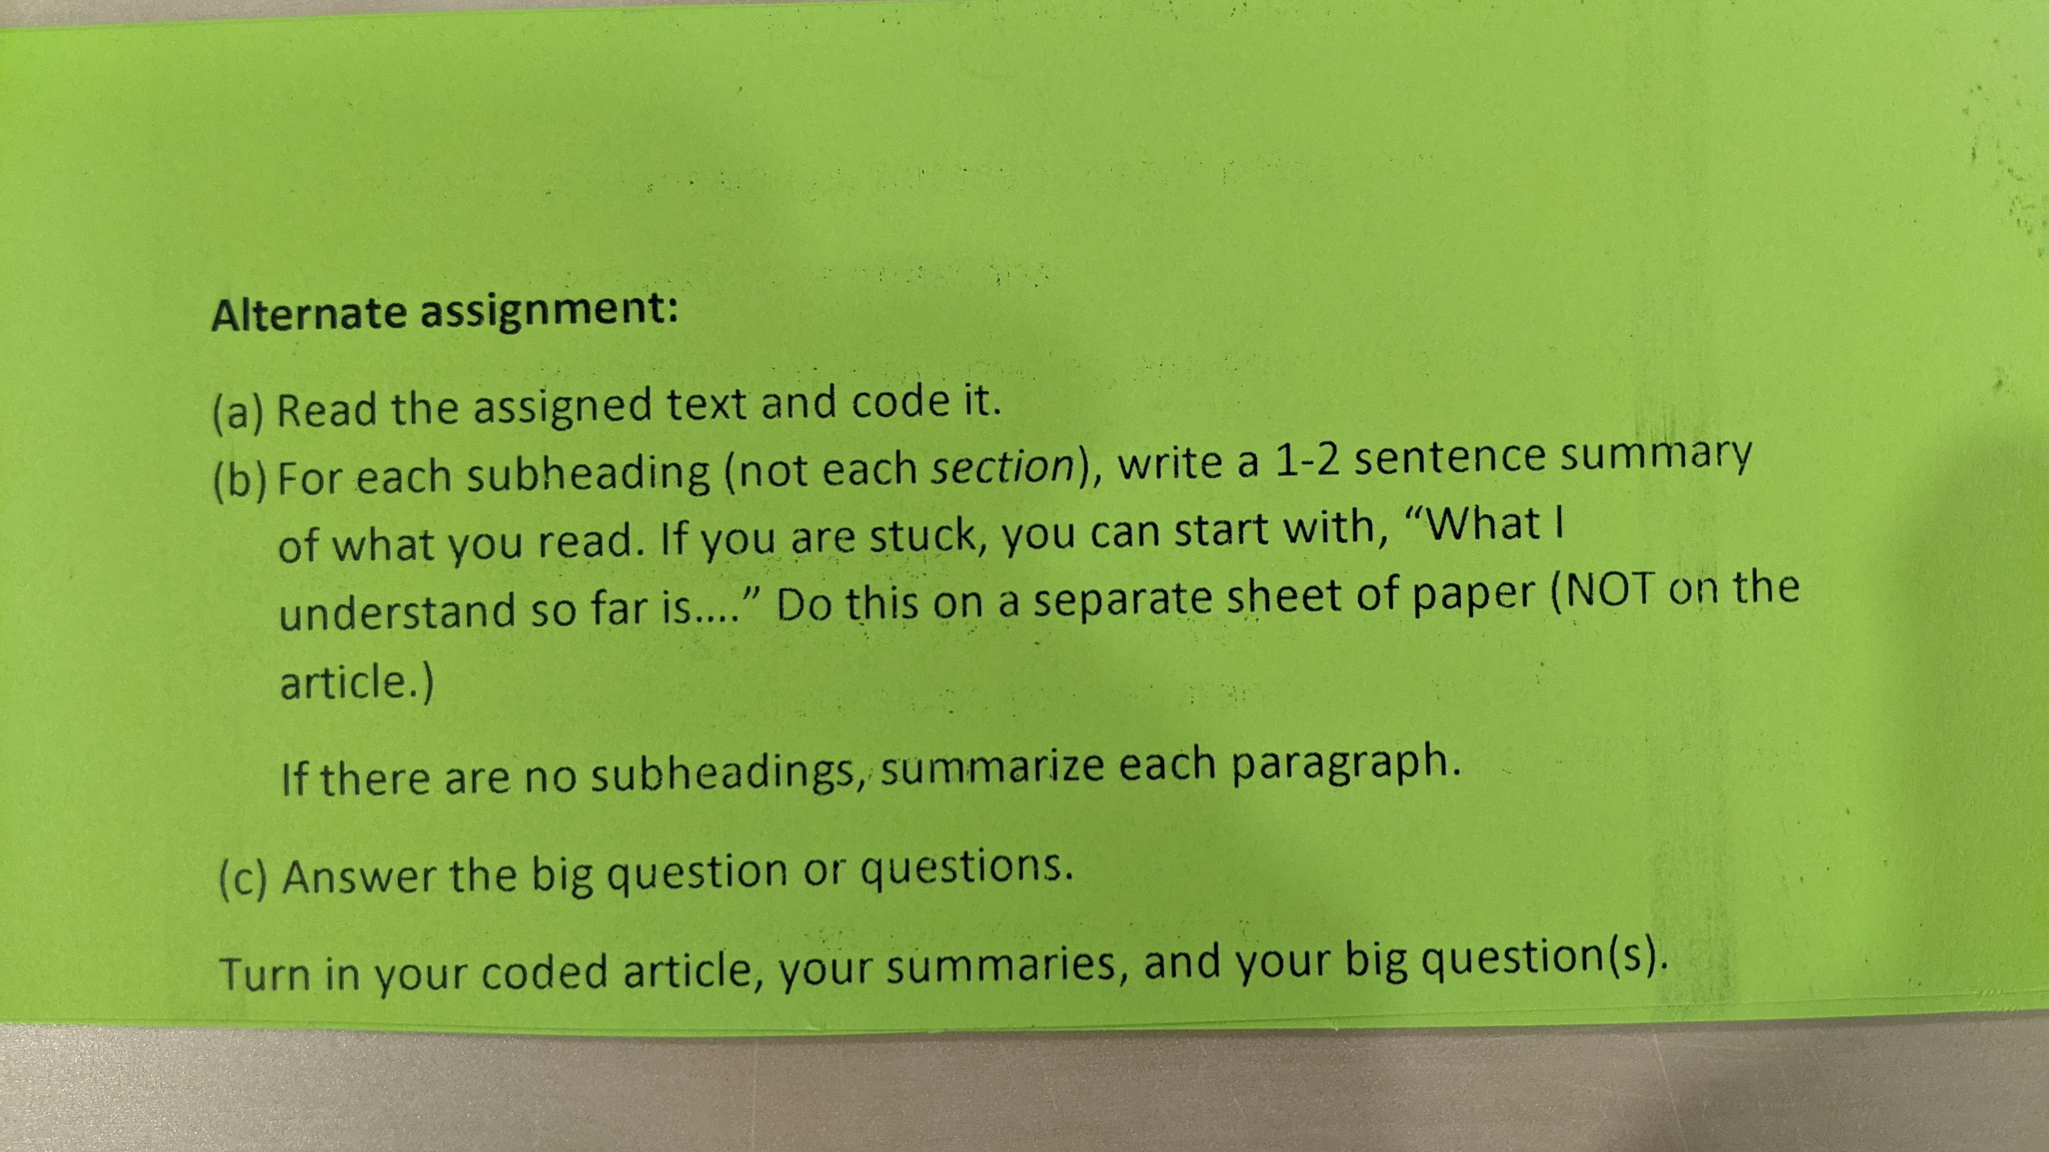

Slide 21
Variations on the Procedure (pick one and stick with it for awhile)
Ask: What ideas in the section were interesting, surprising, or bothersome?
Ask: Is there anything else from this section we should discuss?
Ask: Can anyone add something to my summary? (or could leave out the summary and instead add the “interesting, surprising, bothersome” question after the group sorts out any difficulties)

Slide 22
Interacting on Reading Strategies
Join in with groups that are going well and those that are struggling.
What exactly is confusing you? (If “everything,” walk them through the section to pinpoint the problem.)
How did you figure that out?
What can you tell about that word? Is that enough? (Provide background knowledge if needed)
What can you tell from that diagram that you didn’t get from the words?
I wonder if re-reading this section would help.

Slide 23
It Gets Easier!
It may take several tries for your students to become comfortable with the procedure and be able to focus more deeply on the content.
You will get more comfortable (and skilled!) and interacting with the groups in a way that guides reading skills.
Remember, this has the power to transform how your students interact with academic text. It’s worth the energy expended to get going.

Slide 24
Reflection Point 1
Jot your thinking at this point. Consider questions such as:
What part of what we’ve been doing/ talking about makes sense to you?
What ideas for your own class do you have now?
What do you disagree with or what would you do differently?
What thoughts do you just need to get out of your head?
What questions do you have?
Would anyone like to share any thoughts or questions?

Slide 25

Dig Deeper: Writing

Slide 26
Classroom writing falls on a spectrum.
Writing to Learn (exploratory)
Writing for a Finished Product
Experiences
Discussions
Reading, Reading, Reading
I’m an Expert!
Experience
Reading
Discussion
What am I learning?
Writing
Proofreading
End Product
Revision, Revision, Revision
Notes:
Ask yourself where this writing task is falling on the spectrum. Keep your expectations in check for what you’ve decided they are doing.

Slide 27
Raise your hand if you have ever…
Put off answering an email that was going to require a lot of thought?
Failed to write a thank-you note you knew you should write?
Started to keep a journal but then it petered out?
Procrastinated in writing up a report on something that you needed to get done?
Writing is hard work.

Slide 28
It’s easier if you have something you want to say.
Notes:
This is why it helps to put the writing as the caboose on the train.

Slide 29
The more time you spend helping students prepare to write, the better your results will be.

Slide 30
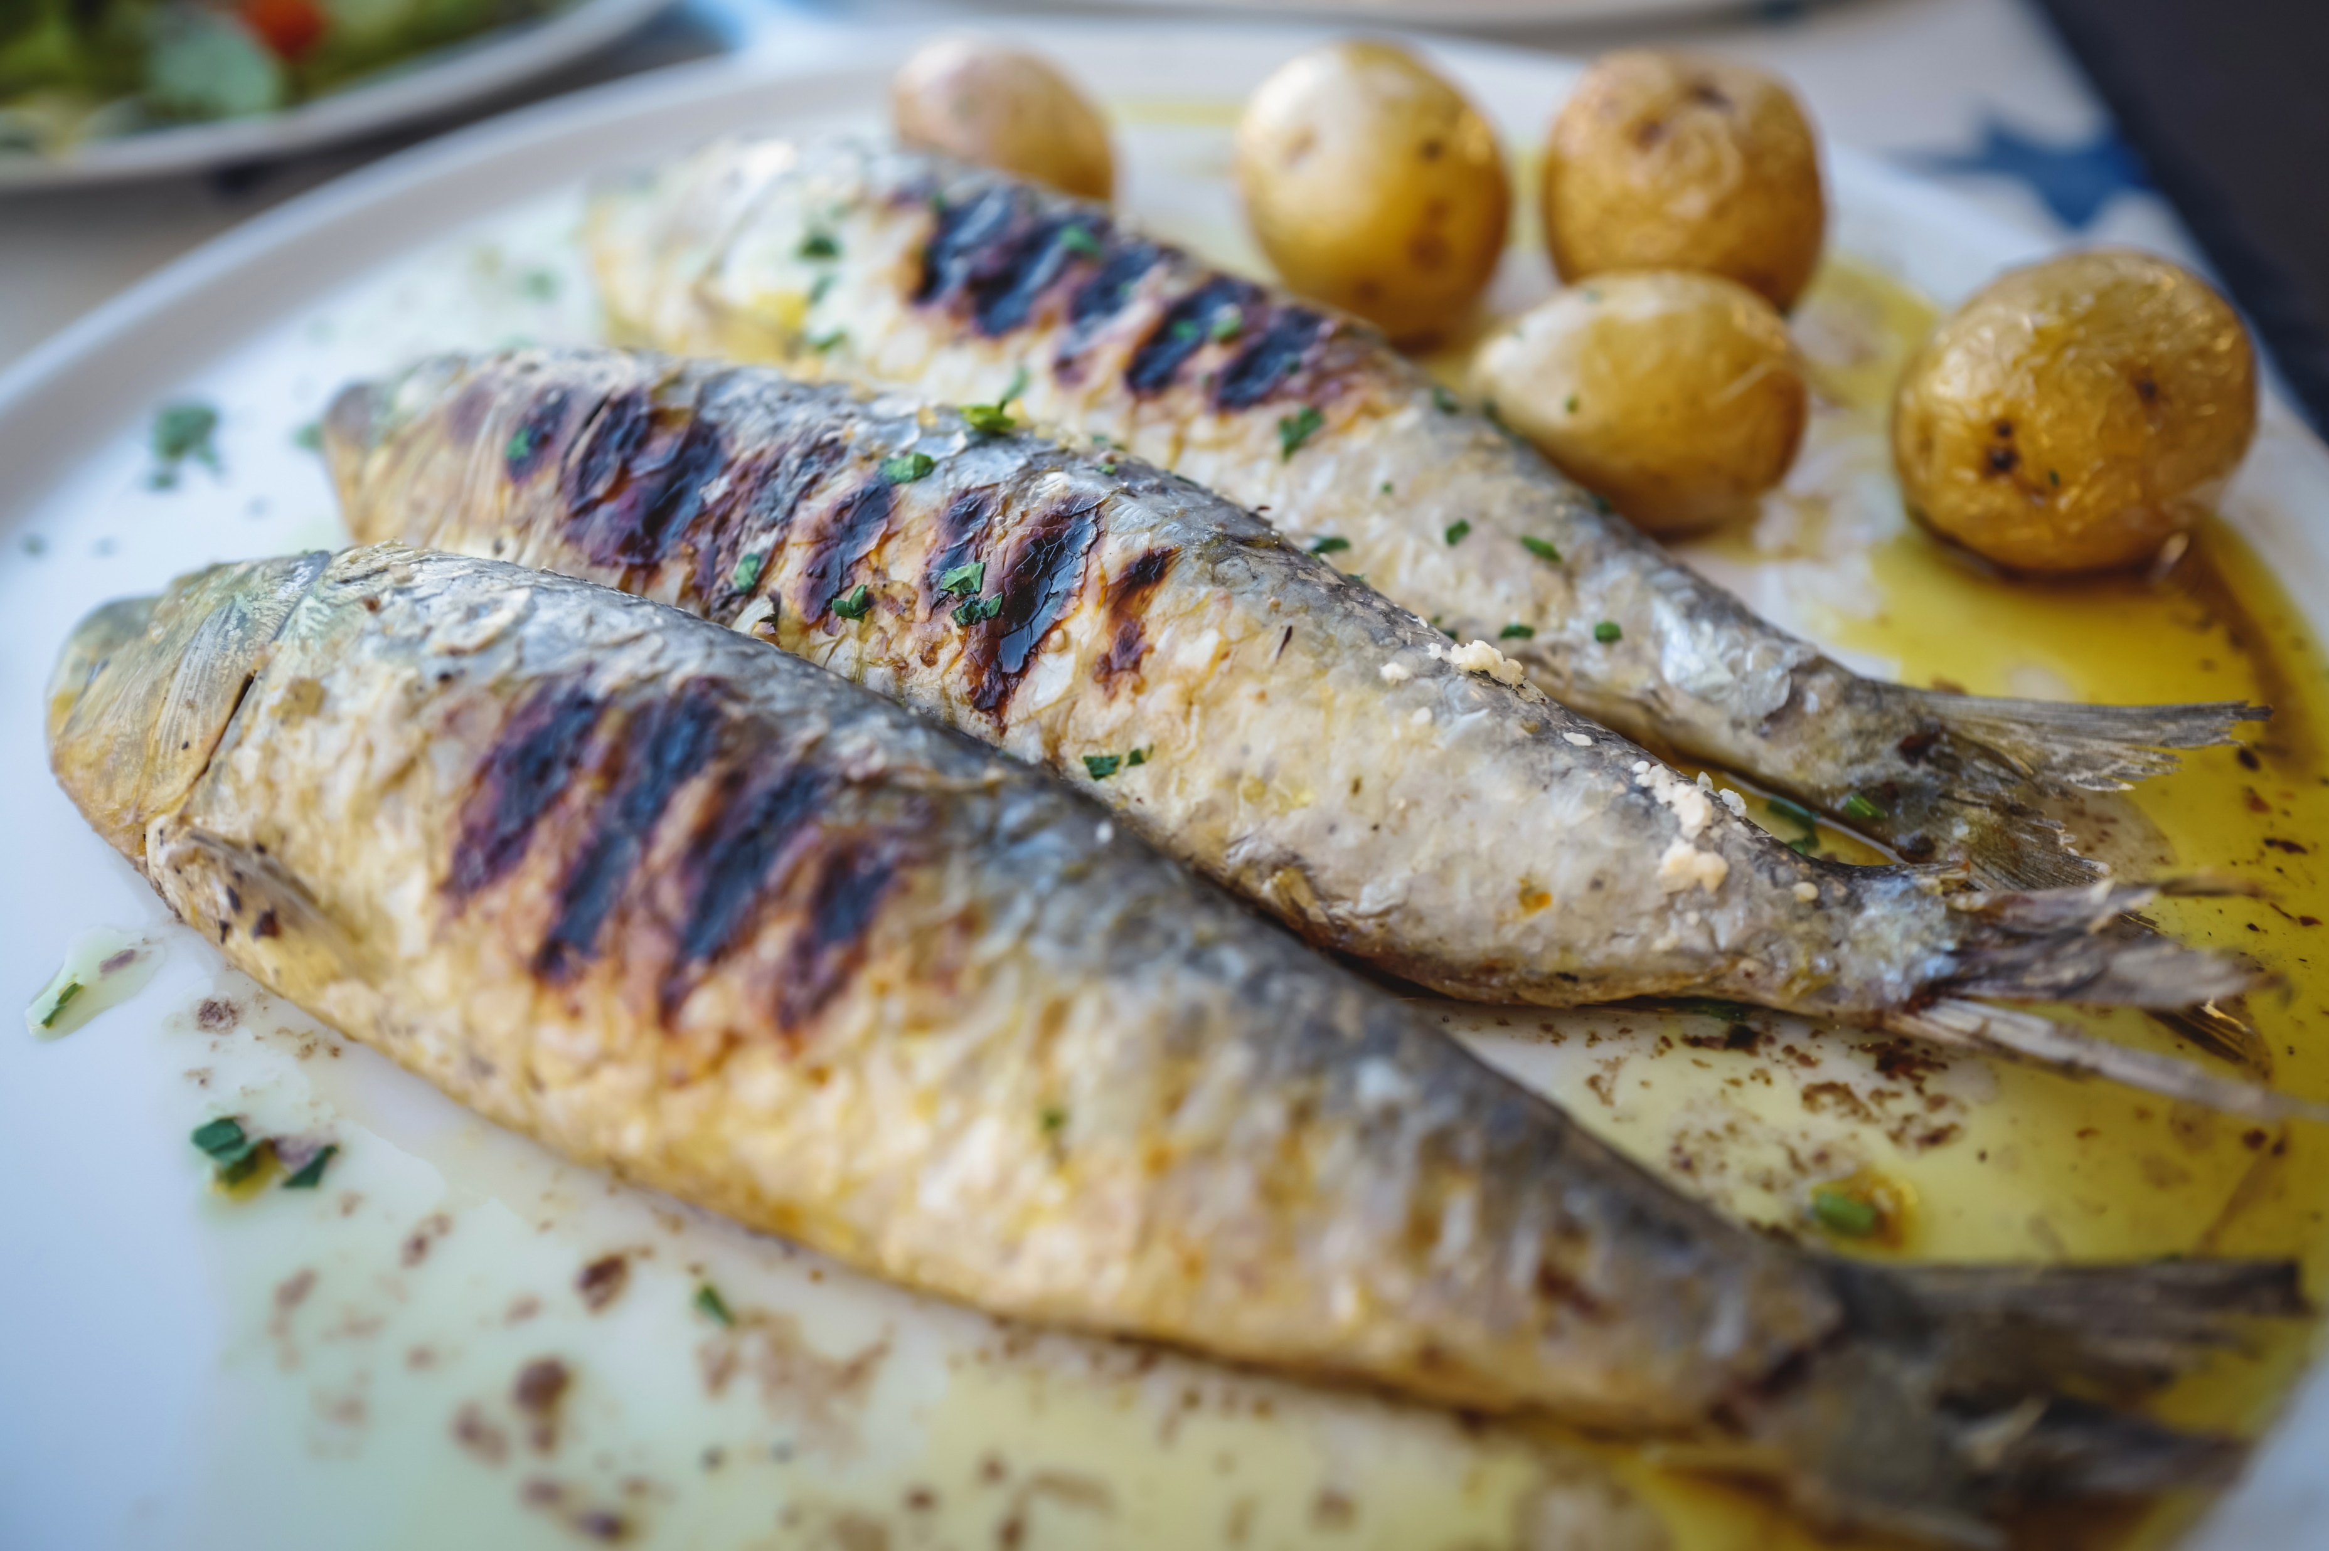
Biology Sample Lesson: Fish for Dinner?

Slide 31
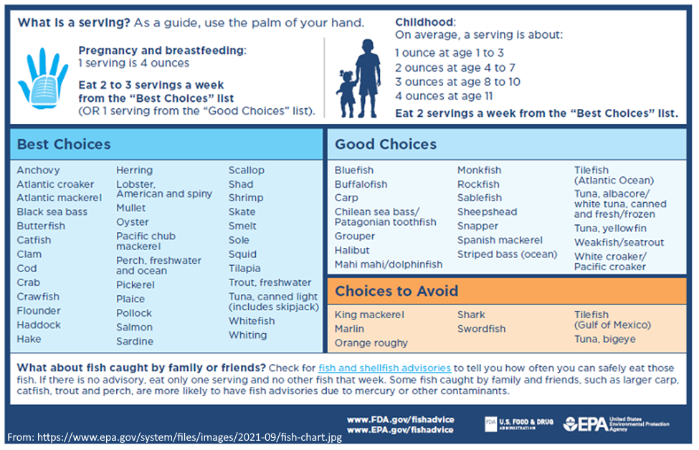

Slide 32
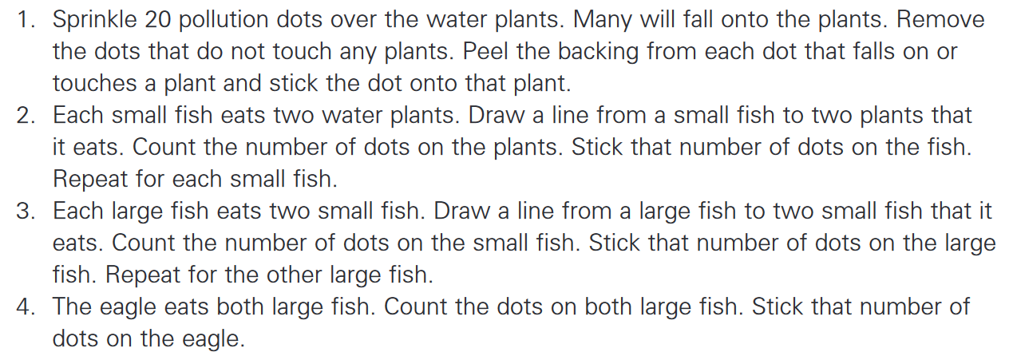
Here Comes Some Pollution…

Slide 33
Bioaccumulation
Polluting toxins can be taken in by living things if breathed in, consumed in food or water, or absorbed through their skin. Some toxins break down into harmless substances quickly before they can affect living things. Many species can deal with exposure to these toxins in small levels. They do not stay in the organisms, and most are excreted, or removed from the body in urine.
However, some polluting toxins cannot be excreted. These toxins can be taken in by the organisms at the bottom of the food chain in low levels and so the harm is limited. These organisms are almost always plants or algae.
The primary consumer, which eats the plants or algae, also eats the toxins within it. The toxins in this stage become concentrated.
Eventually the apex predator eats the animal below it in the food chain as well as the concentrated toxins within it.
Because the toxins cannot be excreted, they are found in much higher concentrations in the organism at the top of the food chain, and the effects are much more severe. This build-up of toxins that cannot be excreted at the tops of food chains is called bioaccumulation.
(adapted from https://www.bbc.co.uk/bitesize/topics/zhssgk7/articles/z7x6xbk)

Slide 34
Writing Skill: Cause and Effect (frames)
__(cause)___ causes ____(effect)_____by _______________ .
Since/Because/Due to ____(cause)_ , _______(effect) .
__(effect) _____, since/because/due to__(cause)_ .
Since a fish cannot ______________, ___________________________.
Since a fish cannot excrete the toxin, it keeps all the toxin it has ever eaten in its body.

Slide 35
Fish for Dinner?
Compare the Pacific Ocean food web to the list of fish recommended by the EPA.
Try again to answer the question: Why are some of the fish more unsafe than others? That is, what is it about a fish that makes it more likely to be on the "choices to avoid" list rather than the "best choices" list?
In your answer, include at least 3 of the vocabulary words from our word wall. [or, include the words trophic level, food chain, and bioaccumulation]
You may want to include the sentence you wrote earlier!

Slide 36
How could we frame this?(students must help!)
The EPA ranks fish based on ______________________________________.
Some pollutants, like ____________, cannot be _____________________.
The plants __________________________. Then the ______________________ _____________________________________.
Since the fish cannot excrete the toxin, it keeps all the toxin it has ever eaten in its body.
The fish that should be avoided are all _____________________________. They have the most _________________________.
This process is called __________________________.

Slide 37
E-X--P---A----N-----D
Add a “because” to your response.
Add a “for example” to your response.
Add a picture or diagram to your response. (Be sure to refer to it in words, with something like, “As you can see in the diagram…”)

Slide 38
Summary: Options for scaffolding writing
General pre-writing questions (as discussed in the article)
Teaching generic sentence frames or writing words and having them available for student use.
Practicing using a particular sentence frame before a writing assignment.
Framing the entire piece (or part of the piece) with the class or with a struggling individual. (Or providing a frame for a particular student)
Asking students to add to their responses using the EXPAND prompt.
Mix and match to meet the level of need in your class or for specific students. Try to reduce supports at the year progresses.

Slide 39
Reflection Point 2
Jot your thinking at this point. Consider questions such as:
What part of what we’ve been doing/ talking about makes sense to you?
What ideas for your own class do you have now?
What do you disagree with or what would you do differently?
What thoughts do you just need to get out of your head?
What questions do you have?
Would anyone like to share any thoughts or questions?

Slide 40

Teaching Science Vocabulary

Slide 41

How we teach vocabulary in ELA:
Ignite
=
To catch on fire

Slide 42
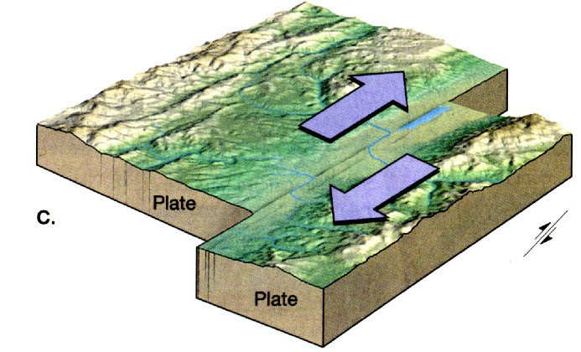
Science (and sometimes social studies) is different
Transverse fault = nothing they’ve ever heard of
Tectonic plates
Plates move
Plates interact
Plates can slide opposite each other

Slide 43

We need to look at how children learn words for “whole new ideas”

Slide 44
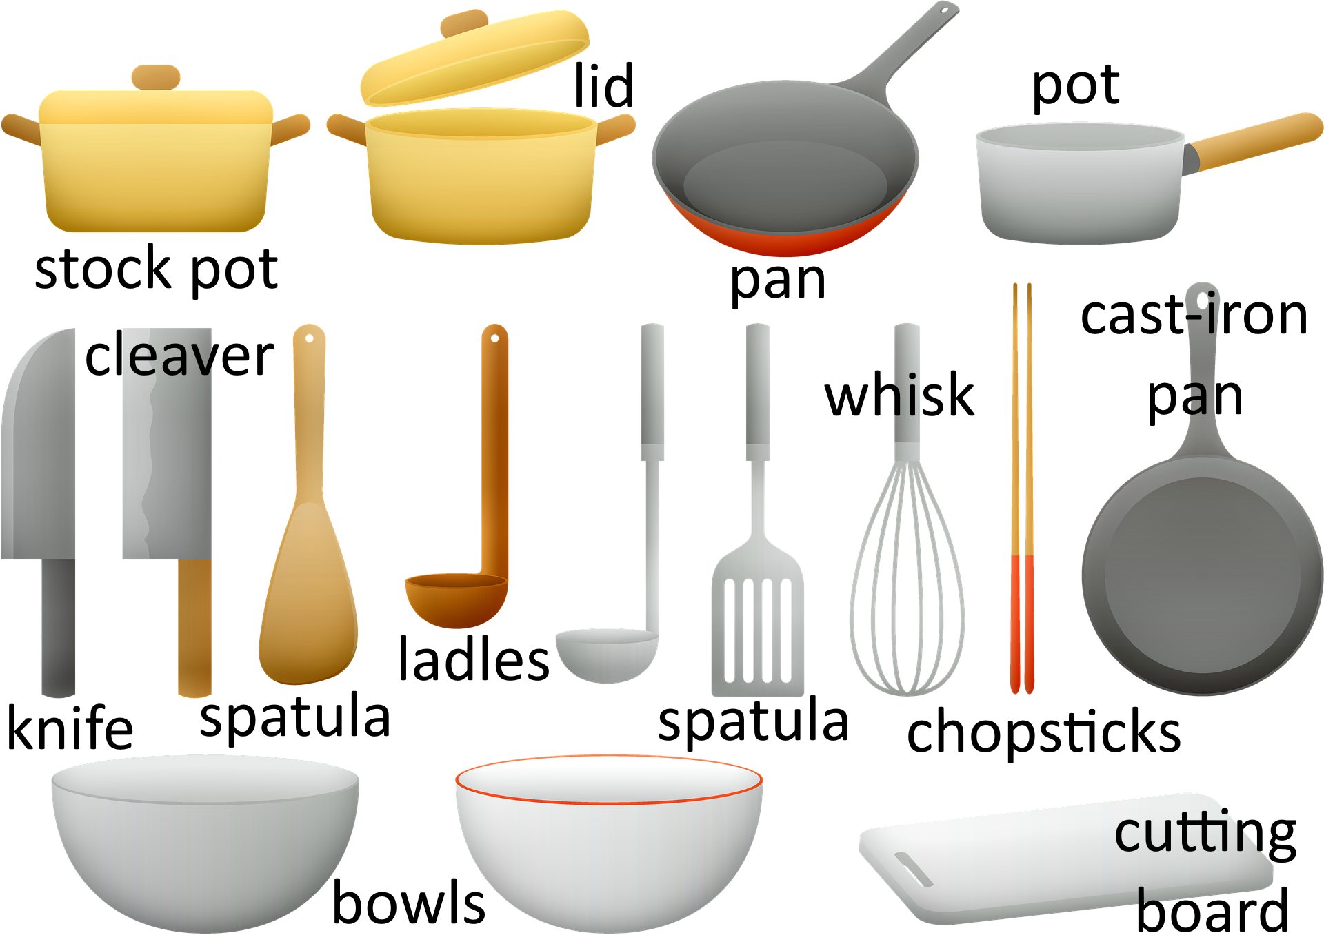
Say a 4-old is going to “help” us cook dinner….

Slide 45
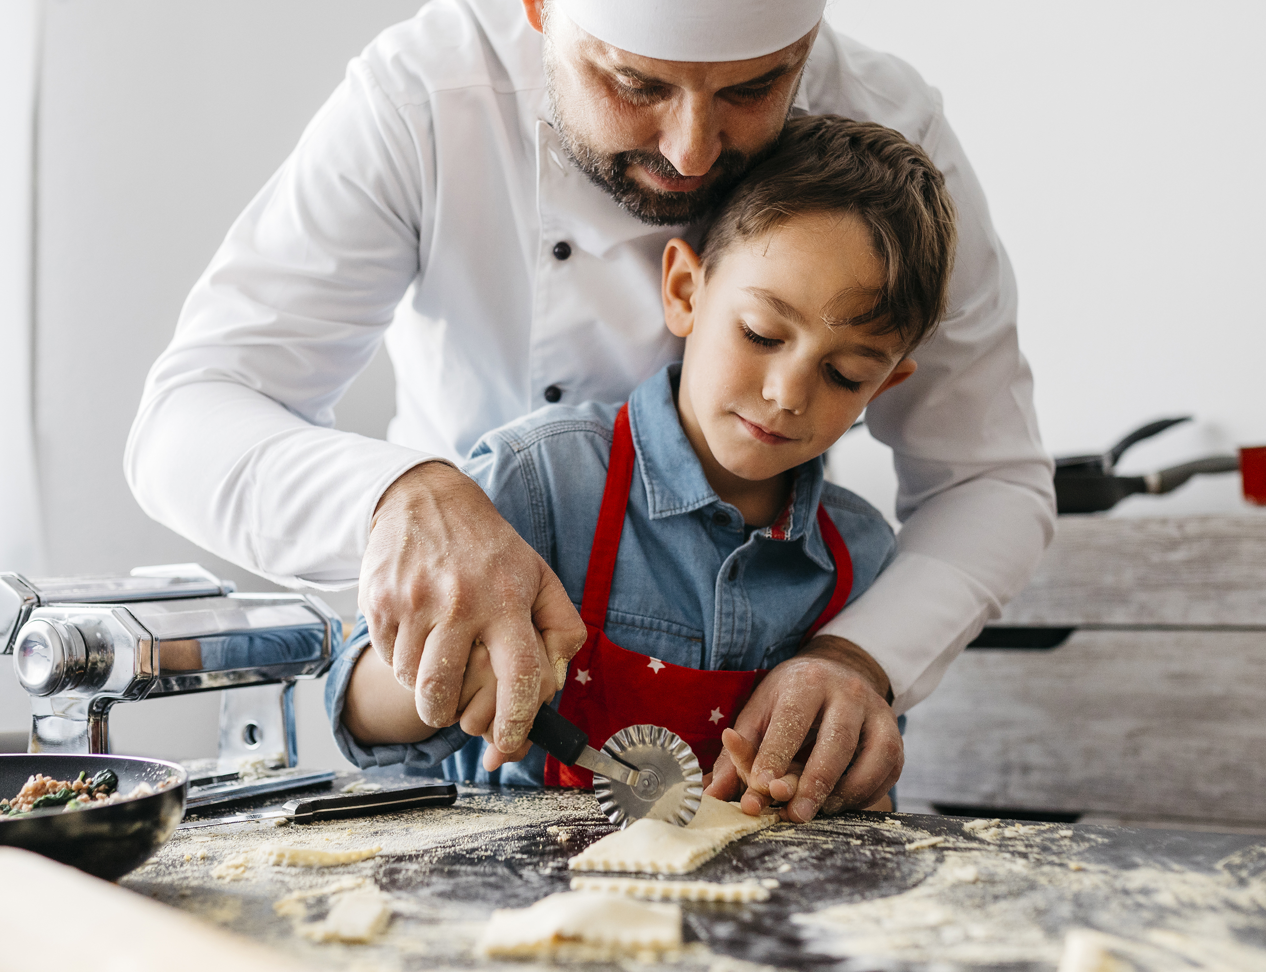
People learn new concept vocabulary best when the word comes right when they need it

Slide 46
In science, the “ideal time” for a new word is just after the child has grasped the new idea.

Slide 47
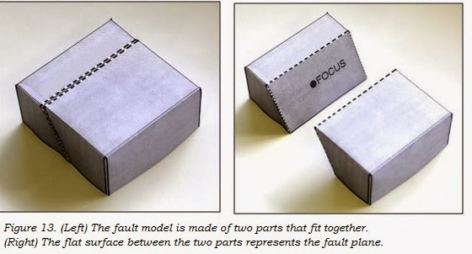
Returning to the “transverse fault”

Slide 48
What does this mean for our lessons?
Do NOT start with a list of vocabulary words to learn.
Most words will be introduced in the text that the students read after their exploration.
Occasionally, it may make sense to have a word or two introduced during the exploration (at just the right time!).

Slide 49
Then they need to practice the word!
It becomes theirs when they USE it.
Have students say it in sentences to a partner or the class.
Have students go back and label things from their exploration/ pre-reading.
Have writing assignments or questions that specifically ask students to use their new words.
Word walls are great tools. (“That’s a good explanation. Look at the word wall. What science word could you include? Can you rephrase what you were saying to use that word?”)

Slide 50
Reflection Point 3
Jot your thinking at this point. Consider questions such as:
What part of what we’ve been doing/ talking about makes sense to you?
What ideas for your own class do you have now?
What do you disagree with or what would you do differently?
What thoughts do you just need to get out of your head?
What questions do you have?
Would anyone like to share any thoughts or questions?

Slide 51
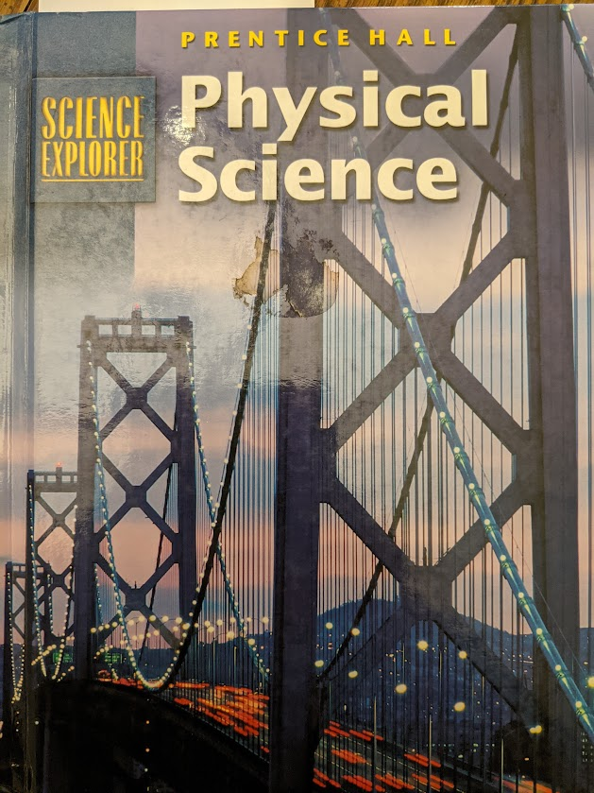
Let’s brainstorm a little on setting up a lesson like this.
Simple topic: Friction
Scan the pages from the textbook. Things to think about:
  Which ideas are most important for you, in your setting? (Note: not necessarily the ones the author stressed.)
  Which ideas are most complex and may need more “thinking time” for students?
  What knowledge does this text assume? Will your students have that knowledge? (think vocabulary and ideas)
Use these questions to help you think about what kind of exploration will best prepare them for this information.

Slide 52
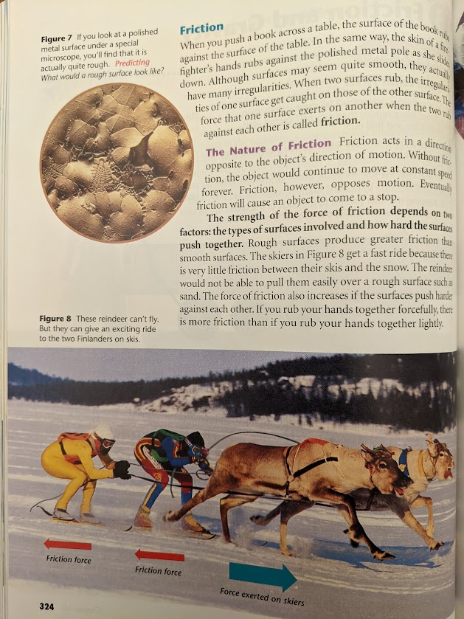
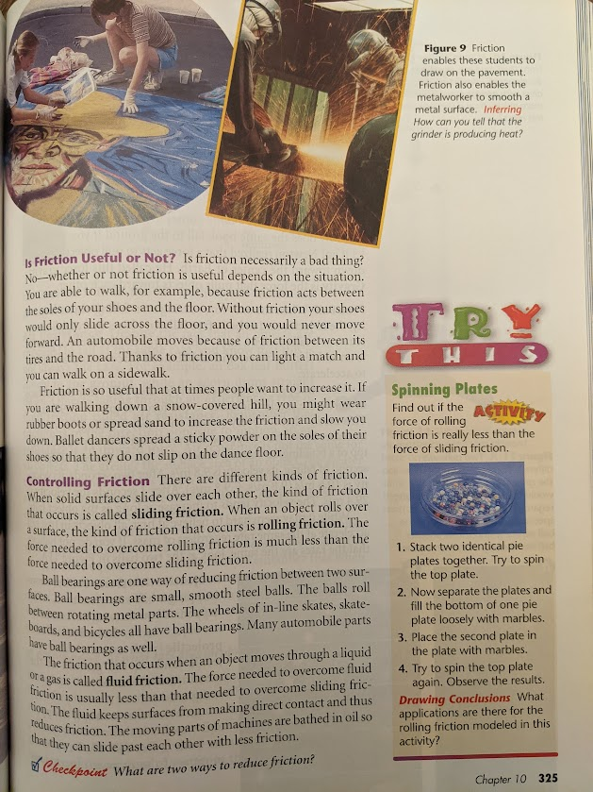

Slide 53
What exploration ideas do you have?

Slide 54
What writing prompt ideas do you have?
Once again, this is going to depend on the context in which you are teaching friction.
Some types of questions that make good writing prompts:
They might explain an observation they made during the exploration. (Ie, why did the lightbulb only light for some of the circuits?)
They might practice their new vocabulary to re-describe something they saw in the exploration. (Ie, Describe what happened when you sprayed your mountain with water, using the words erosion and deposition.)
They might apply their knowledge to a new situation. (Ie, Suppose a lego man fell off a boat off the coast of Savannah. Where would you expect it to go and why?)
They might propose an engineering solution. (Ie, See this thing I built…I’m losing too much energy at this spot. Propose a way to reduce how much energy is getting used up there and explain why it would help.)

Slide 55
Reflection Point 4
Action Items. List specific things you want to do to follow-up on things you learned/ thought about today.
Plan to put this list somewhere where you will see it and act on those items.
Would anyone like to share any thoughts or questions?

Slide 56
Challenge:
Describe a possible exploration.
Consider what text options you have for the explanation.
  Is there a reading strategy you want to introduce? Supports you want to give during reading, such as reading groups or the option to listen to the text on audio?
What could you have as a writing prompt?
  What prewriting/ scaffolding would you like to provide?

Slide 57
Related Resources
https://onceuponasciencebook.com/for-educators/resources-for-teaching-online-with-the-once-upon-books/

Slide 58
Georgia DOE Literacy Learning Cycles
Kindergarten Day and Night
First Grade Light
Second Grade Shadows
Third Grade Fossils
Fourth Grade Ecosystems
Fifth Grade Erosion
6th Grade Science Literacy Task: Tornadoes
7th Grade Science Literacy Task: Cells
8th Grade Science Literacy Task: Mixtures
GA DOE may be looking for writers for this style lesson for next summer. I can put your name in if you are interested.

Slide 59

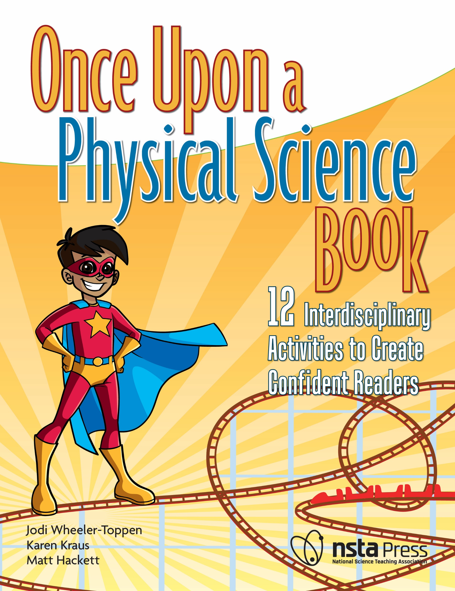

Where can I find more support for reading and writing strategies?

Slide 60

Elementary:
Integrating Writing and Science
Integrating Reading and Science
Writing about Claims, Evidence, and Reasoning
Sentence Frames for Reading, Writing, and Forming Science Knowledge
Middle/High:
Integrating Writing and Science:
Integrating Reading and Science:
Signal Words for Reading, Writing, and Forming Science Knowledge
Writing about Claims, Evidence, and Reasoning:
K-12:
Reading Strategies Part 1: Make it Make Sense: For Teachers in Grades K-12
Reading Strategies Part 2: Problem-Solving Tools
Knowing Enough to Read: How Background Influences Science Comprehension
Before and After Writing: Prewriting and Evaluation
Integrating Reading, Writing, and Science in the K-8 Classroom: A Call to Action for Administrators​

