Slide 1
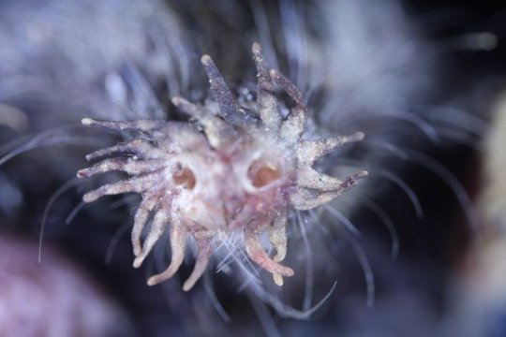
Bubble Shapes and Mechanics
Alexander (Bo) Lee

Slide 2
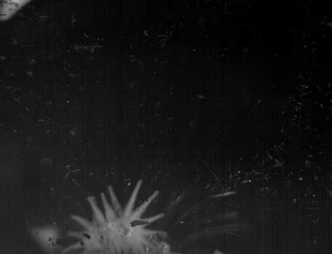

Star-nosed moles show us how to use noses underwater
Body Mass: 50 g
Bubble Volume: 0.1 mL
Timescale: 0.1 sec
Catania, 2006

Slide 3
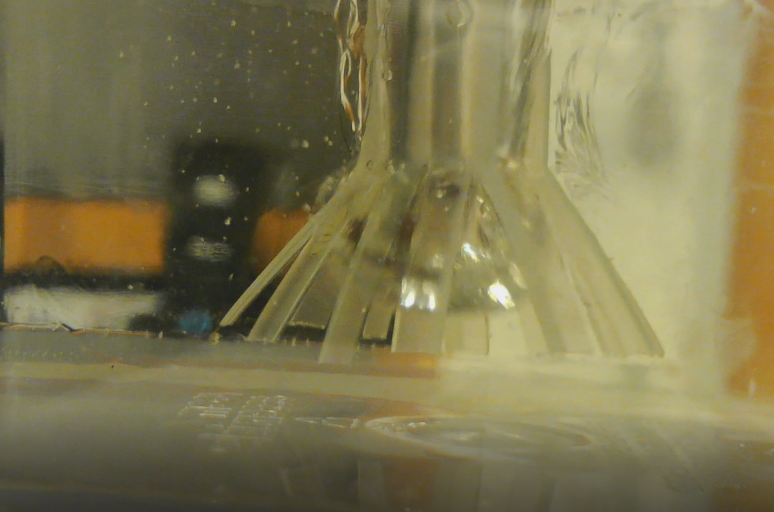
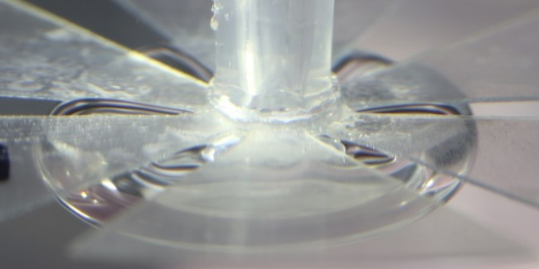
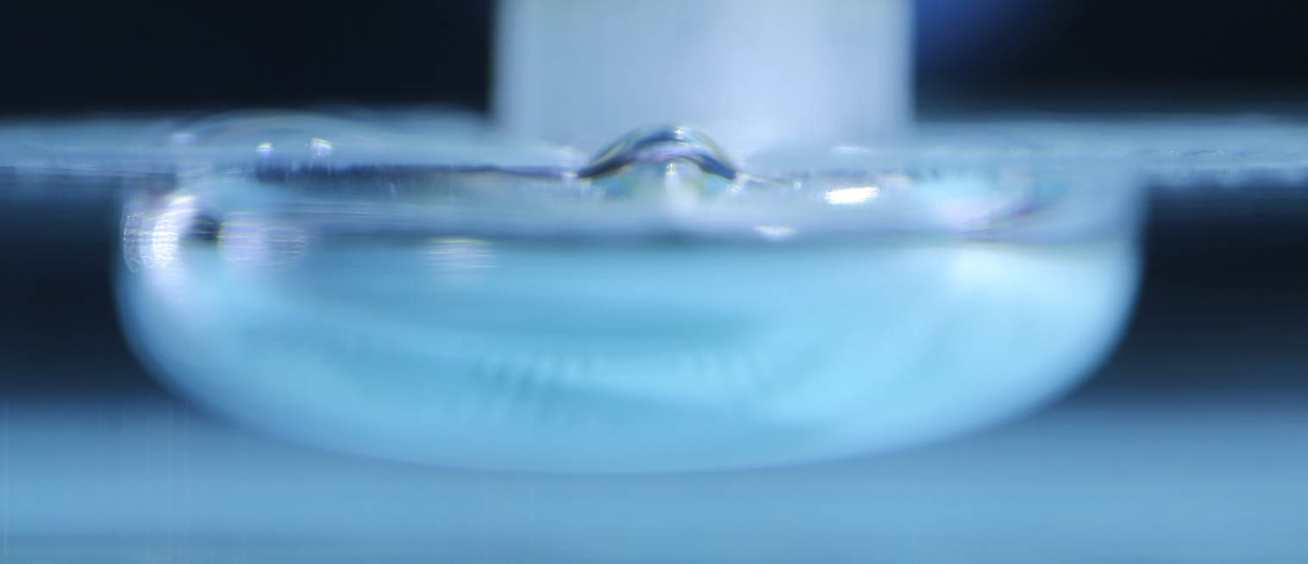
Investigating bubbles with our own star-noses

Slide 4
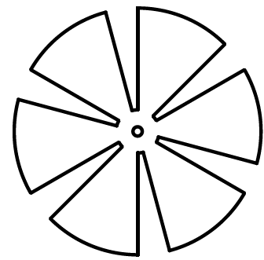

A closer look at our plastic stars
Start with circle of radius 2 cm
Cut 6 gaps
Size of gap based on 𝜃
Preserve inner circle of radius 0.3 cm
Cut hole of radius 0.01 cm for syringe nozzle
$$\text{θ}$$

Slide 5

A closer look at the bubble
Bubble takes the shape of a cylinder
Height of 0.3 cm
The bubble is like a puddle of water. As you add more, the puddle does not get taller, it just spreads out more
$$H=0.3 cm$$

Slide 6
Bubbles can squeeze through the gap when the width of the gap is greater than 0.3 cm
Practice Problem:
Our star has a gap angle of 30° and we form a bubble of 0.9 cm³. Will the bubble squeeze through the gaps?
(Hint: Remember that the bubble is a cylinder of height 0.3 cm. We can use trigonometry to find the width of the gap)

Slide 7
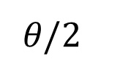
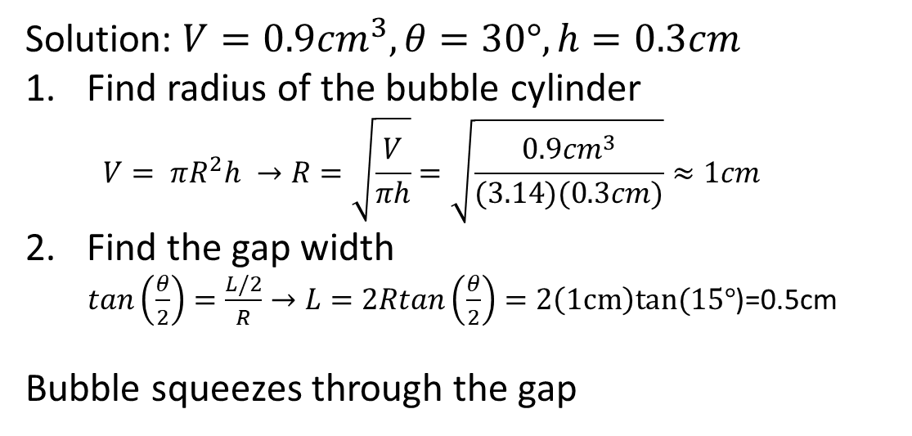
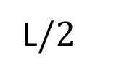

Bubbles can squeeze through the gap when the width of the gap is greater than 0.3 cm
Solution: $V=0.9{cm}^{3}, θ=30°, h=0.3cm$
Find radius of the bubble cylinder
  $$V= πR^{2}h →R=\sqrt{\frac{V}{πh}}=\sqrt{\frac{0.9{cm}^{3}}{(3.14)(0.3cm)}}≈1cm$$
Find the gap width
$tan\left(\frac{θ}{2}\right)=\frac{L/2}{R}→L=2Rtan\left(\frac{θ}{2}\right)=2\left(1cm\right)tan(15°$)=0.5cm
Bubble squeezes through the gap
𝜃$/2$
L$/2$
$$R$$

Slide 8
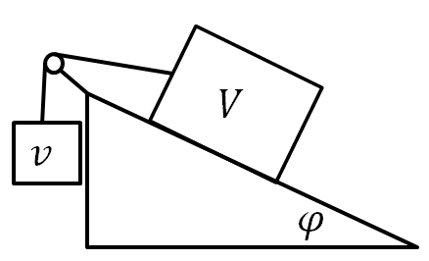
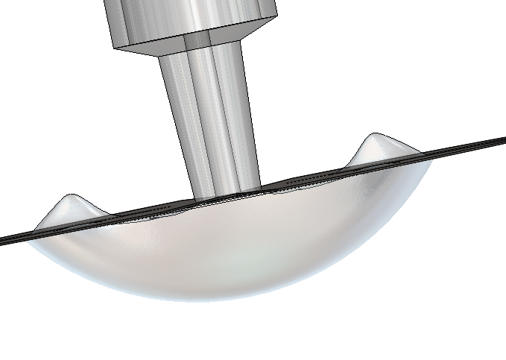

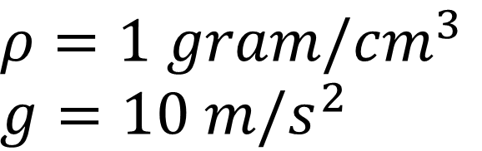




Bubbles are like any other object, they just fall up instead of down
$$g$$
$$V−v$$
$$v$$
$$V−v$$
𝜙
$$ρ=1 gram/{cm}^{3}$$
$$g=10 m/s^{2}$$
$$F=ρ∗g∗Vol$$

Slide 9
Bubble force balance
Practice Problem:
Our star has three gaps of angles of 3°. We blow a bubble of 0.225 cm³. The star with the bubble is tilted 5°
(Hint: Remember that the bubble is a cylinder of height 0.3 cm. Find the counterweighting bubble volume, then subtract it from the total to find the load. Remember that the load is on an angled surface)
$$g$$
$$V−v$$
𝜙

