Slide 1





Literacy & Science
An NSTA Press Authors’ Workshop
Writing Strategies
Grades 3-5
Jodi Wheeler-Toppen
(Could I have a couple of volunteers
before we start?)

Slide 2
Agenda
Who are you and what science writing questions do you have?
First Activity: Blanket Science
What the standards say: Opinion Writing
Helping Students Use “Opinion Writing” in Science: Claims and Evidence
What the standards say: Informative/ Explanatory Writing
Second Activity: Is that my salamander?
Helping students with Informative/ Explanatory Writing in Science: Description

Slide 3

Activity 1: Blanket Science
How does a blanket work?
(your ideas)

Slide 4
Writing: Persuasive
CCSS.ELA-Literacy.W.3.1
Write opinion pieces on topics or texts, supporting a point of view with reasons.
  CCSS.ELA-Literacy.W.3.1.c
  Use linking words and phrases (e.g., because, therefore, since, for example) to connect opinion and reasons.
CCSS.ELA-Literacy.W.4.1
Write opinion pieces on topics or texts, supporting a point of view with reasons and information.
  CCSS.ELA-Literacy.W.4.1.c
  Link opinion and reasons using words and phrases (e.g., for instance, in order to, in addition).
CCSS.ELA-Literacy.W.5.1
Write opinion pieces on topics or texts, supporting a point of view with reasons and information.
  CCSS.ELA-Literacy.W.5.1.c
  Link opinion and reasons using words, phrases, and clauses (e.g., consequently, specifically).

Slide 5
Where they are going—6th grade
CCSS.ELA-Literacy.W.6.1
Write arguments to support claims with clear reasons and relevant evidence.
This is the practice of science!

Slide 6
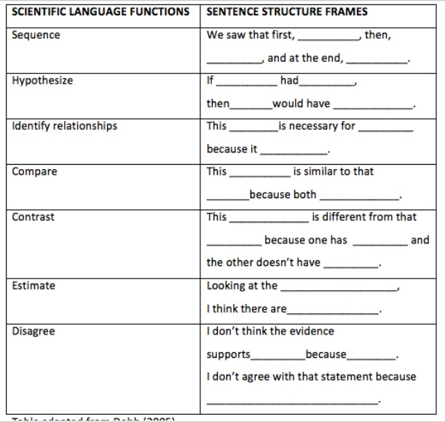
Adapted from:
Dobbs, F. (2005). Introducing English learners to the language of science: One discourse pattern at a time. California Science Project. University of California.

Slide 7
Simple Evidence Frames
When we ______________________, we saw that _______________. This evidence tells me that _________________________.
If _____________________ , then ________________ would have ______________________. However…

Slide 8
Blanket Science: Results

Slide 9
Blanket Science: Prewriting questions
What science words will you want to use?
    (heat, temperature, Fahrenheit)
What writing words might you use?
  (more and less/ higher and lower)

Slide 10
3rd Grade Response (initial)
Claim: A blanket traps heat.
Evidence: The one on our body got pretty warm and the one under the blanket got even warmer because the blanket trapped the heat. The ones on the table were the exact same 26 and that’s because the table didn’t give off any heat.

Slide 11
3rd Grade Response (revisit)
Claim: A blanket traps heat.
Evidence: The one on our body got pretty warm and the one under the blanket got even warmer because the blanket trapped the heat. The ones on the table were the exact same 26 and that’s because the table didn’t give off any heat.
If _____________________ , then ________________ would have ______________________. However…
If a blanket makes heat, then the one on the table would have gotten hot, too. However, both thermometers on the table were 26.

Slide 12
Generic Pre-writing Questions
Make a quick list of ideas you want to include.
Number them in the order that they would make the most sense to your reader. (Warm up to this one as a class using sentence strips, and trying out different orders and linking words.)
What science words will you want to include?
What writing words will you want to include?
Would one of our frames be useful?
Are you going to use everyday language or school language?

Slide 13
GPS
S3P1.Students will investigate how heat is produced and the effects of heating and cooling, and will understand a change in temperature indicates a change in heat.
S4E4. Students will analyze weather charts/maps and collect weather data to predict weather events and infer patterns and seasonal changes.
a. Identify weather instruments and explain how each is used in gathering weather data and making forecasts (thermometer, rain gauge, barometer, wind vane, anemometer).
5th—really nothing.

Slide 14
Writing: Descriptive (grades 3-5 are very similar)
CCSS.ELA-Literacy.W.4.2
Write informative/explanatory texts to examine a topic and convey ideas and information clearly.
  CCSS.ELA-Literacy.W.4.2.a
  Introduce a topic clearly and group related information in paragraphs and sections; include formatting (e.g., headings), illustrations, and multimedia when useful to aiding comprehension.
  CCSS.ELA-Literacy.W.4.2.b
  Develop the topic with facts, definitions, concrete details, quotations, or other information and examples related to the topic.
  CCSS.ELA-Literacy.W.4.2.c
  Link ideas within categories of information using words and phrases (e.g., another, for example, also, because).
  CCSS.ELA-Literacy.W.4.2.d
  Use precise language and domain-specific vocabulary to inform about or explain the topic.
  CCSS.ELA-Literacy.W.4.2.e
  Provide a concluding statement or section related to the information or explanation presented.

Slide 15
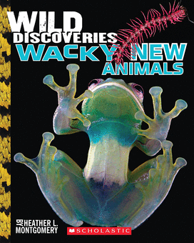
Activity 2: Is that my salamander?
Adapted from an activity by Heather Montgomery, and from her book Wild Discoveries: Wacky New Animals (Scholastic, 2013)
(She does excellent author visits that blend writing instruction and science content. See her website at www.heatherLmontgomery.com)

Slide 16
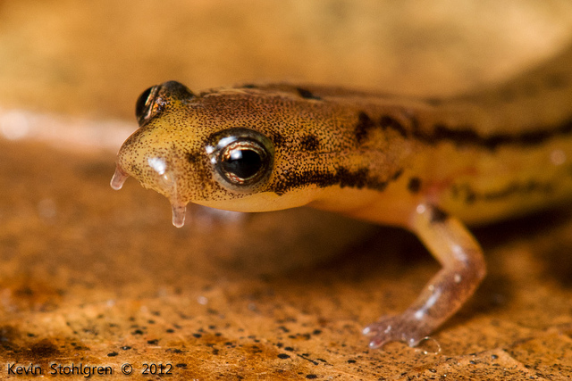
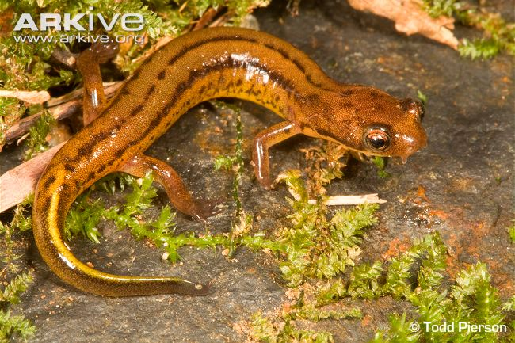
Patch-nosed Salamander
Discovered 2009 in a stream in Georgia
by Bill Peterman

Slide 17
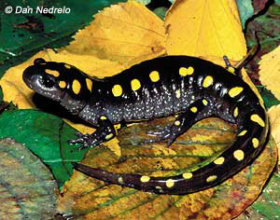
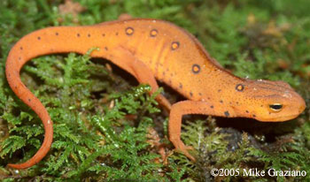
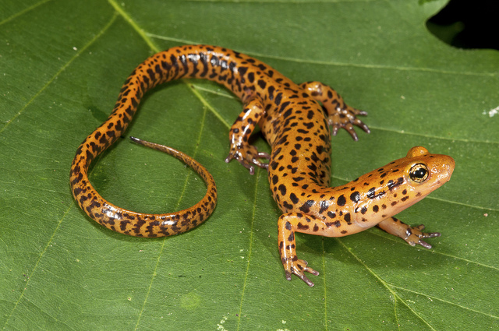
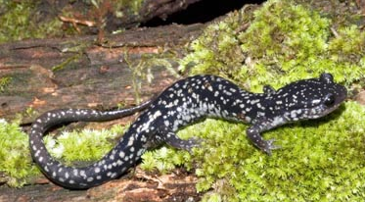
2
1
4
3
Notes:
1) Spotted salamander (Ambystoma maculatum)
2 ) Eastern Newt (Notophthalmus viridescens)
3) Slimy salamander (Plethodon grobmani)
4) Long Tailed salamander (Eurycea longicauda)

Slide 18
Compare and Contrast Frames
This ______________ is similar to that ______________ because both __________________.
This ____________ is different from that ______________ because one has _____________, while the other has_____________.
Remember– you can do these orally in pairs or chorally. It still builds writing skills.

Slide 19
Questions?
Consider this your reminder to participate in the Harvard study.
You can find this power point—with the frames—posted at my website: www.OnceUponAScienceBook.com

